Slide 1
Early Childhood Guidance and Best Practices
Early Childhood Administrator Meeting
March 27, 2018

Slide 3
State Board of Education Goals FIVE-YEAR STRATEGIC PLAN FOR 2016-2020
All Students Proficient and Showing Growth in All Assessed Areas
Every Student Graduates from High School and is Ready for College and Career
Every Child Has Access to a High-Quality Early Childhood Program
Every School Has Effective Teachers and Leaders
Every Community Effectively Uses a World-Class Data System to Improve Student Outcomes
Every School and District is Rated “C” or Higher

Slide 4
Agenda
Executive Function and Self-Regulation
Importance of Purposeful Play
Policy and Guidance
Schedules and Transitions
Summer Food Service Program

Slide 5
Executive Functioning
and
Self Regulation

Slide 6
Executive Function and Self Regulation
Executive function and self regulation skills are the mental processes that enable us to plan, focus attention, remember instruction, and juggle multiple tasks successfully. These skills are critical to lifelong learning.
Notes:
Executive function skills are essential in helping children develop strong cognitive skills and social and emotional skills. The brain needs these skills to filter distractions, prioritize tasks, set and achieve goals, and control impulses. They enable positive behavior and allow us to make healthy choices for ourselves. Children who develop strong executive function are better able to form and maintain positive social connections with others, problem solve, think more flexibly and persist at tasks.

Slide 7
Executive Function and Self Regulation
Video on executive function
Center on the Developing Child at Harvard University
https://youtu.be/efCq_vHUMqs

Slide 8
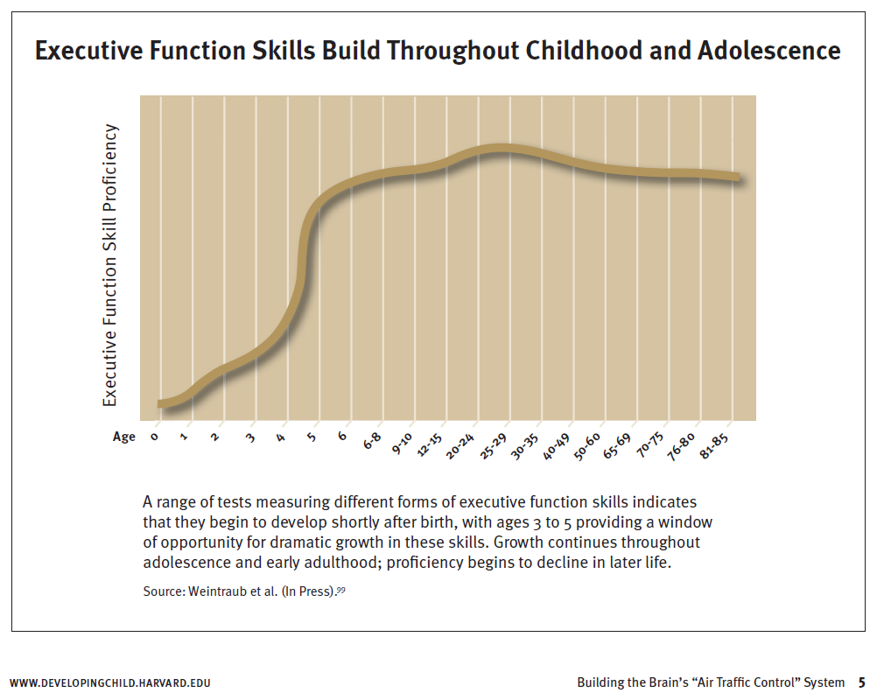
Executive Function

Slide 9
Working Memory
Mental Flexibility (Cognitive Flexibility)
Inhibitory Control (Cognitive Self-Control)
Executive Function
Executive Function and Self Regulation
Relies on three types of brain processes:

Slide 10
Executive Function and Self Regulation
Working memory refers to our ability to hold onto information so that one can act on that information at a later time.
For example: remembering their role/scene in a play
Standards this example would cover: TH:RE8.1.K, TH:PR6.1.K, TH:PR5.1.KA, TH:PR5.1.KB, TH:PR4.1.KA

Slide 11
Executive Function and Self Regulation
Mental flexibility (cognitive flexibility) refers to our ability to maintain attention and to shift attention in response to different demands or roles in different settings.
For example: building a tower; if it falls, child uses another strategy
Standards this example would cover: K.G.3, K.G.4,K.G.6, P.K.5B.1, P.K.5B.2, P.K.5B.3, L.K.1, SL.K.3, SL.K.6, VA.CR1.1.K, VA.CR2.1.K
Notes:
What could that strategy be? How can the teacher ask questions to encourage the child to figure out a different way to build the mental flexibility skills?

Slide 12
Executive Function and Self Regulation
Inhibitory control (self control) enables us to set priorities and resist impulsive actions or responses.
For example: When frustrated; instead of hitting/kicking, the child is able to stop and think before acting
Standards this example would cover: SS.CHR.3B, SS. CHR.3D
Notes:
Children are not born with these skills but are born with the potential to develop them. If children do not get what they need from their relationships with adults and the conditions in their environments, their skill development can be seriously delayed or impaired. If a child is under toxic stress such as abuse,neglect, or violence, their brain development is disrupted. Therefore, executive function is not developed.

Slide 13
Executive Function: What You Can Do – Start Early!
establish routines
model social behavior
create and maintain supportive relationships
foster creative center time and social connections
teach children how to cope with stress
provide opportunities for directing own actions with decreasing adult supervision (This is done over time.)
provide daily physical activity (exercise)

Slide 14
Importance
of
Purposeful Play

Slide 15
Importance of Purposeful Play
Planning and providing children with varied activities and support throughout the day play a key role in helping children develop executive function skills. Therefore, provide many opportunities and support for pretend play.

Slide 16
Play in a Kindergarten Classroom
Pretend play is a healthy part of every child’s social, emotional, and cognitive development.

Slide 17
How Play Supports Development
Social skills are fostered
Appreciation for relationships with others
Instantiate and sustain social relationships with peers
Fosters emotional regulatory skills
Allows children to practice directing and negotiating action

Slide 18
How Play Supports Development
Building positive emotional expressiveness
Expresses more positive emotion
Engagement, thoughtfulness, understanding
Expresses less negative emotion
Selfishness, need for attention, anger
Score higher on tests of emotional regulation and emotional understanding

Slide 19
Play in a Kindergarten Classroom
There are two basic types of pretend play:
fantasy play
sociodramatic play
(Lindsey & Colwell, 2013)

Slide 20
Fantasy Play
Primarily occurs in ages 2 though 5.
Peaks during the preschool years when children begin to interact with other children their own age and gain access to more toys and resources.
10-17% of all preschoolers’ play behavior can be grouped under this category.
Child will continuously verbalize state of pretend, meaning the child does not stay completely in character and will continue explaining what he or she is pretending to be or do.

Slide 21
Sociodramatic Play
Once the guidelines for the pretend storyline are set, the child is completely immersed in this story and does not typically emerge from character to restate that something is pretend.
Usually takes the form of an extended social narrative and imitates storylines that the child has been exposed to: Superman, Sleeping Beauty, home life, or a dog.

Slide 22
Play in a Kindergarten Classroom
This type of play benefits all areas of a child’s development and gives a child tools for experiences later in life such as emotional regulation, creativity, and logical reasoning.
Join in children’s pretend play to help guide their storyline, but allow children to expand their knowledge of the world around them by playing “make believe.”
https://www.psychologytoday.com/us/blog/moral-landscapes/201404/is-pretend-play-good-kids

Slide 23
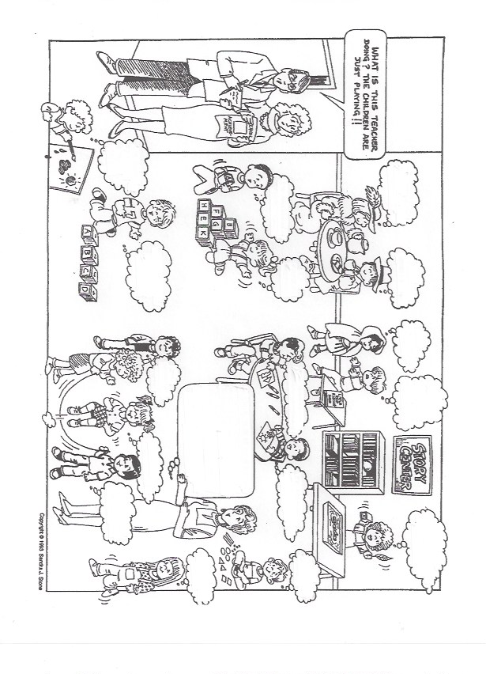
What is going on in this classroom all day?

Slide 24
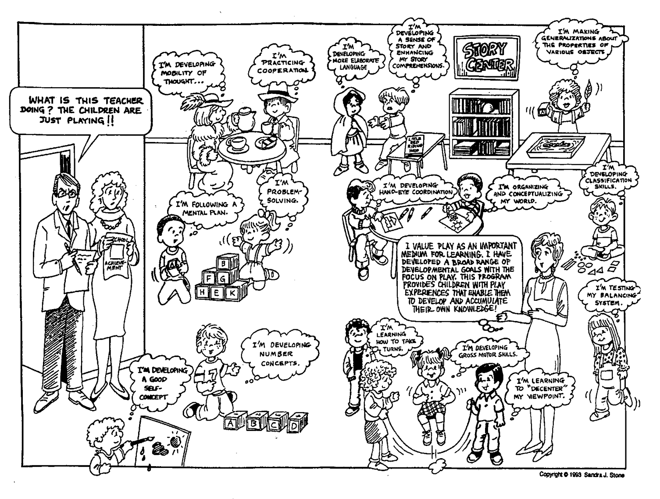
What is going on in this classroom all day?

Slide 25
The Importance of Play
Pretend play helps children develop working memory
ex. what props represent various items in a skit
Standards: TH:PR4.1.K, TH:PR5.1.KB
Pretend play helps children develop cognition
ex. think through different perspectives such as rule changes in a game
Standards: TH:PR6.1.KA, TH:RE9.1.KA
Pretend play helps children develop inhibitory control
ex. how to share two dolls with three people
Standards: TH:PR4.1.KA, TH:CN10.1.K

Slide 26
The Importance of Play
You can support children in pretend play by:
Asking questions and supporting recall of details.
What happened first, next, last?
Tell me details about your trip to the store.

Slide 27
The Importance of Play
Connecting with children about things that interest them as they create and discover. Ask questions such as:
What are you observing?
Why do you think that happened?
How can we solve it?

Slide 28
The Importance of Play
Modeling problem solving by showing them how to stay in control so they can focus on solutions. For example:
“It looks like there might be a problem deciding who gets the blue train. Let’s take a deep breath and calm down. Let’s talk about how you are feeling, what the problem is and how we can solve it.”

Slide 29
The Importance of Play
Gradually increase the difficulty over time
If a child masters a five-piece puzzle, increase the difficulty by offering a puzzle with more pieces such as a seven or ten piece puzzle.

Slide 30
Let’s Take a Break……..
15 minutes

Slide 31
Policy and Guidance

Slide 32
Kindergarten Guidelines
Class Roster
1:22 or 2:27
Instructional Time
330 minutes
Gross Motor Time
30 minutes
Learning Center Time
120 minutes
Quiet Time
recommended
Master Schedule
school length & term = same as other grades
Notes:
Keep copies of screenings in cumulative record
Proposed change- from 30 days to 45 days

Slide 33
Kindergarten Guidelines
Family Handbook with policies and procedures
Family Communication – twice a year
Professional development in early childhood and reading instruction each school year for teacher assistants, teachers, and administrators
Hearing/Vision Screenings conducted within first 30 days of school
Notes:
Keep copies of screenings in cumulative record
Proposed change- from 30 days to 45 days

Slide 34
Kindergarten Lesson Plans
Large and small group activities
Learning centers (minimum of three)
Guided physical activity
Individual instructional activities
Integrate content areas (English/Language Arts, Mathematics, Science, Social Studies, Physical Education, Health, The Arts)
Unit/thematic format

Slide 35
Kindergarten Lesson Plans
Minimum of three learning centers
Reference the Mississippi College and Career Readiness Standards
Reference the Mississippi Curriculum Frameworks for Kindergarten

Slide 36
Scheduling
and
Transitions

Slide 37
Sample Kindergarten Schedule
Time | Activity | Minutes
7:00-7:30 | Arrival/Free Choice Centers | 30
7:30-7:50 | Morning Routine | 20
7:50-8:00 | Morning Exercise (Move to Learn) | 10
8:00-8:30 8:30-9:30 | Whole Group Small Groups and Learning Centers | 30 60
9:30-10:15 | Extension Class/Teacher Planning (music, library, physical education, computer, art) | 45
Notes:
Define Instructional Day- Time when students enter the classroom until the time students leave the classroom.

Slide 38
Sample Kindergarten Schedule
Time | Activity | Minutes
10:15-10:40 | Whole Group/Circle Time | 25
10:40-11:05 | Lunch | 25
11:05-12:25 | Small Group Learning Centers | 80
12:25-12:55 | Recess/P.E./Move to Learn | 30
12:55-1:50 | Small Group/Free Choice Centers | 60
1:50-2:10 | Story Time/ Speaking Listening Mini Lesson/Snack | 20
2:10-2:25 | Closure/Review of the Day | 15
2:25-2:35 | Dismissal | 10
2:35-3:30 | Teacher Planning | 55
Notes:
Define Instructional Day- Time when students enter the classroom until the time students leave the classroom.

Slide 39
Did you know?
Kindergarteners spend less than 5% of their time in free choice, child directed activities compared with the 35% seen in prekindergarten programs.
(Conn-Powers, Cross, & Dixon, 2011)
Notes:
Research shows that children who spend more time in classrooms that balance teacher directed activities such as group and individual instruction with free choice have greater opportunities to engage in academic activities and teacher interactions that support academic growth.

Slide 40
How Transition is Defined
Students physically moving to a different place in an intentionally structured, routine manner.
If you save 15 minutes a day through more efficient transitions, that will result in 45 extra hours of instructional time per year.
Resource Article: Mastering Classroom Transitions, Todd Finley; George Lucas Educational Foundation
Notes:
List a few typical ways instructional time is lost due to transition: teacher preparation, materials not ready, children misunderstanding directions, waiting to move to the next activity, etc.

Slide 41
Transition Tips
Pre-plan movements (arrange the environment for success)
Don’t assume a child knows how to transition properly
Make it fun
Be consistent
Prepare children for transitions before they occur (3 to 5 minute warning before transitioning when possible)
Use non-verbal clues (if the transition song or movement allows use movements or words from the thematic unit)
Notes:
These are evidenced-based strategies/practices that support smooth transitions between activities. (Resource: What Works Brief from the Center on the Social and Emotional Foundations for Early Learning)

Slide 42
What’s New for Kindergarten
We anticipate the following:
Best Practice Recommendation Guidance Document for Teachers and Administrators
Update of Kindergarten Guidelines

Slide 43
Summer Food Service
Program

Slide 44
MDE Office of Child Nutrition
The Office of Child Nutrition administers the federal child nutrition programs, including:
National School Lunch Program and School Breakfast Program
Summer Food Service Program
Child and Adult Care Food Program
At Risk After School Meals

Slide 45
Summer Food Service Program
Mississippi is ranked 49th for providing summer meals to children who receive free or reduced price lunch.
Mississippi provides only 8% of our low-income children with summer meals. The most successful state provides 49% of these children with summer meals.
Schools make GREAT sponsors because they already know how to operate the USDA child nutrition programs!

Slide 46
Summer Food Service Program
Provides free meals when school is out for children 0-18
Operates in low-income areas (most of the state qualifies)
In 2017, 89 school districts participated
Reimbursement works similarly to the National School Lunch Program

Slide 47
At Risk After School Meals
The At Risk After School Meals Program is a component of the Child and Adult Care Food Program (CACFP) that offers federal funding to After School Programs that serve a meal and/or snack to children in low-income areas.
Some schools offer a snack under the National School Lunch Program, but the At Risk After School Meals Program allows schools to offer both a snack and/or supper.
Reimbursement works similarly to the National School Lunch Program.

Slide 48
For More Information
Ginger Gibson, Assistant State Director Office of Child Nutrition 601-576-5000 ggibson@mdek12.org
This institution is an equal opportunity provider.

Slide 49
Early Childhood Staff
Jill Dent Director
Monica May Assistant Director
Laura Dickson Early Learning Collaborative Coordinator
Candice Taylor Early Childhood Instructional Specialist/619 Coordinator
Joyce Greer Early Childhood Instructional Specialist

Slide 50
Tenette Smith, Ed.D.
Director
Office of Elementary Education and Reading
tenette.smith@mdek12.org
601-359-2586
Jill Dent, Ph.D.
Director
Office of Early Childhood
jdent@mdek12.org
601-359-2586
Joyce Greer
Instructional Specialist Office of Early Childhood
jgreer@mdek12.org
601-359-2586

Slide 51
Learning Center/Small Group Comparison
Learning Centers | Small Groups
Are student-led | Are teacher-led
Are teacher-created and influenced with specific materials or activities provided that meet state standards | Under teacher direction, include a specific skill or lesson that meet state standards
Encourage independent, discovery learning | Have specific tasks and materials based on individual student data
Provide free choice for learners with uninterrupted learning time | Required activities or tasks for all learners to complete
Are multi-leveled for all learners | Are multi-leveled when using mixed-ability groupings
Can be utilized by individual or groups of 2-5 learners | Are best formed with a balance between homogeneous and heterogenous groups of 2-5 learners

Slide 52
Learning Center/Small Group Comparison
Learning Centers | Small Groups
Occur every day, at a designated time or throughout the day with no time constraints | May occur: - Daily, simultaneously during learning centers time - At a set time of the day with all learners involved - 2 or 3 days a week
Are assessed through observation or completed product | Are assessed through observation or completed product
Are required for a minimum of 120 minutes daily | Last for: A maximum of 15 minutes for pre-k A maximum of 20 minutes for kindergarten

Slide 53
Small Groups
Typically in groups of two to five students
Time for interventions
Time to give targeted and effective feedback
Occurs simultaneously with learning centers
Groups are based on data identified needs

Slide 54
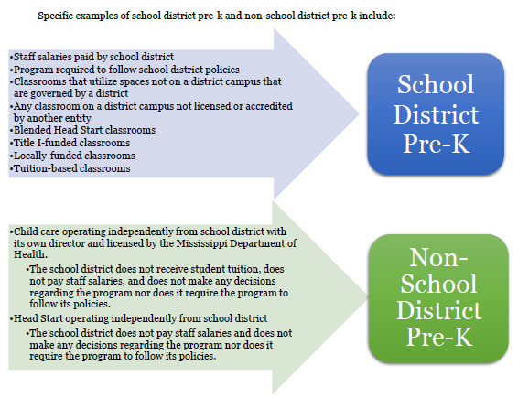
School District Determination Guidance

Slide 55
Teacher-led Whole Group Instruction
Children are engaged in conversation and active discussion in learning
20 minutes of interactive instruction 25 minutes on introduction days
Allows time for explicit modeling, guided practice and independent practice( I do, we do, you do) of new concepts/skills
Notes:
Scaffolding the instruction will be required to meet the individual needs of students as they master the skills of the standards based curriculum.

Slide 56
Differentiated Instruction
When differentiating instruction, content, process, products or learning environment, teachers must use ongoing assessment and flexible grouping varying the levels of difficulty.

Slide 57
Effectiveness Evaluation Plan
Schools providing services to prekindergarten (pre-k) aged children receive an annual evaluation to ensure the effectiveness of services on improving children’s learning and well-being.
Evaluation consists of two parts:
Rate of Readiness
Monitoring
Evaluation occurs for:
The Early Learning Collaboratives (collaborative)
Other Pre-K classrooms (e.g. Title I, local-funded, tuition-based) in Mississippi public schools. (This occurs on a cyclical schedule.)

Slide 58
What is Teacher-led Whole Group Instruction?
Teacher leads and facilitates discussion around concepts to enhance the mastery of standards, skills and concepts students are expected to learn based on the Mississippi College and Career Readiness Standards.

Slide 59
Best Practice Recommendations for Kindergarten

Slide 60
Let’s Take a Break……..

Slide 61
What is Small Group Instruction?
Small group instruction allows teachers to work more closely with each student on a specific learning objective, reinforce skills learned in whole group instruction, skill deficit areas and check for student understanding.

Slide 62
Early Childhood Updates
Kellogg Grant
Data/Reporting Coordinator
Professional Development Specialists
Early Childhood Coaches
Family Engagement/Transition Coaches

Slide 63
Early Childhood Updates
Birth through Third Continuum: Start making the connections…
Birth – 4 year-old standards revision
Use elements of Developmentally Appropriate Practice (DAP) and programs that affect the whole child from pre-kindergarten through third grade – Look at “Magic 8” article findings
Community investment
Connect data of children from the Kindergarten Readiness Assessment through third grade (compare the growth)

Slide 64
Pre-K Readiness Results: Other Funded Pre-K

Slide 65
Kindergarten Readiness Results

Slide 66
What is Differentiated Instruction?
Differentiated instruction is an approach to teaching in which educators actively plan for students’ differences so that all students can best learn.

