Slide 1
IMPLEMENTATION RESOURCES
for MTSS in Mississippi Schools
Presented by
Dawn Miller, PhD & Melanie Salsbury
March 27, 2018
Notes:
Dr. Cathy Grace will introduce us while this slide is up.

Slide 2

Objectives
Who we are
What we do
Resources
Q & A
Notes:
30 sec

Slide 3
Who we are
Resources
Training & Coaching Support
Partners in Transformation
Notes:
5 min
Who We Are
The SWIFT Education Center is housed at the University of Kansas
We share free resources through our website.
We provide differentiated training and coaching supports to meet needs at the State, District, Region, and Building levels.
We also partner with IHE’s, states, districts, and buildings to accomplish innovative and specific programmatic goals.
We have been grateful to work with colleagues across Mississippi within all arenas. Most recently, we have enjoyed a partnership with North Mississippi Education Consortium, Mississippi Department of Education, the University of Mississippi, and Early Childhood and Building sites across the state related to the implementation of MTSS to benefit our youngest students. We will share more about the free training opportunities associated with this partnership today.

Slide 4
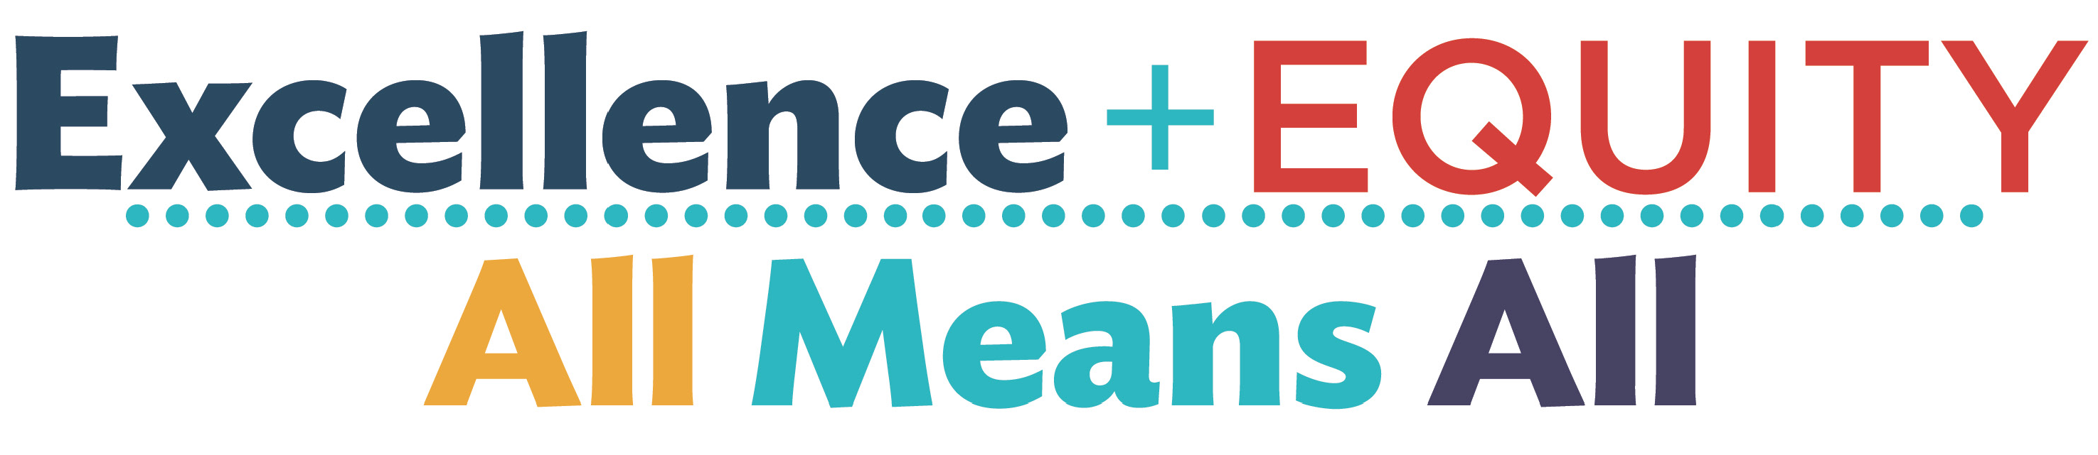
What we do
Notes:
1 min
Our work is driven by supporting transformation efforts that focus on excellence and equity for all – all students, all educators, all families and the communities in which they reside.
We support transformation efforts by providing an evidence-based fr

Slide 5
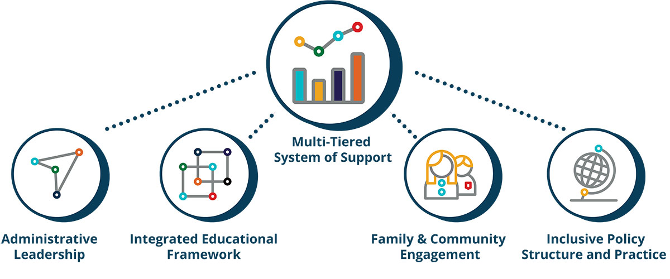
The “What” of Transformation
Notes:
​
Our Framework for Transformation has a multi-tiered system of support (MTSS) as the primary driver of improved outcomes for children in an educational setting. A multi-tiered system of support is a continuum of research-based, system-wide practices of data-based decision making and high quality instruction used to meet the academic and behavioral needs of all youth.
​
​Four other supportive conditions are necessary for implementation and sustainability of an effective MTSS. These are summarized as four evidence-based domains described below:​
​
Administrative Leadership​
Our administrative leadership domain focuses on strong and actively engaged leadership that represents a commitment to improving teaching and learning within a system that empowers educators and school personnel.
​
Integrated Educational Framework​
An integrated education framework encompasses all students, personnel, and stakeholders within a positive school culture and ensures full access for all students to participate in all school-related activities.
​
Family and Community Engagement​
Our Family and Community engagement domain focuses on creating trusting partnerships that are mutually respectful and provide mutual benefits as we attend to whole child needs.
​
Inclusive Policy Structure and Practice​
Inclusive Policy Structure and Practice includes a supportive, reciprocal partnership between LEA’s, schools, and Center-based programs. The partnership demonstrates a clear understanding and protocols to address both supporting the facilitators and adequately addressing encountered barriers.

Slide 6

Notes:
The MTSS information that we just discussed incorporates the same information as Mississippi’s MTSS model.
MDE has a strong commitment to supporting MTSS development to support the academic and behavior needs of all Mississippi youth.

Slide 7
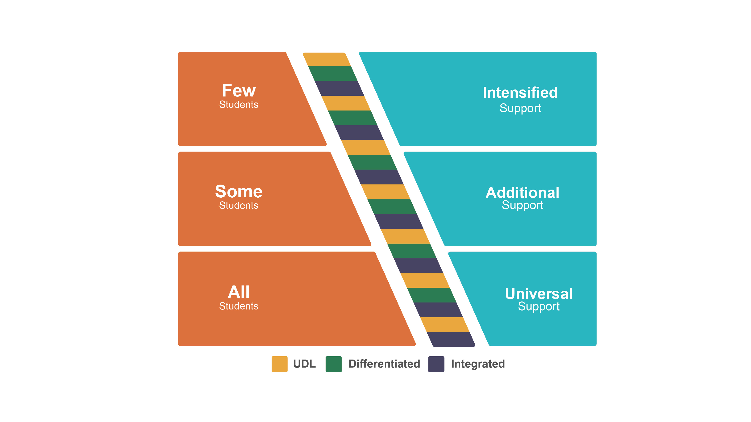
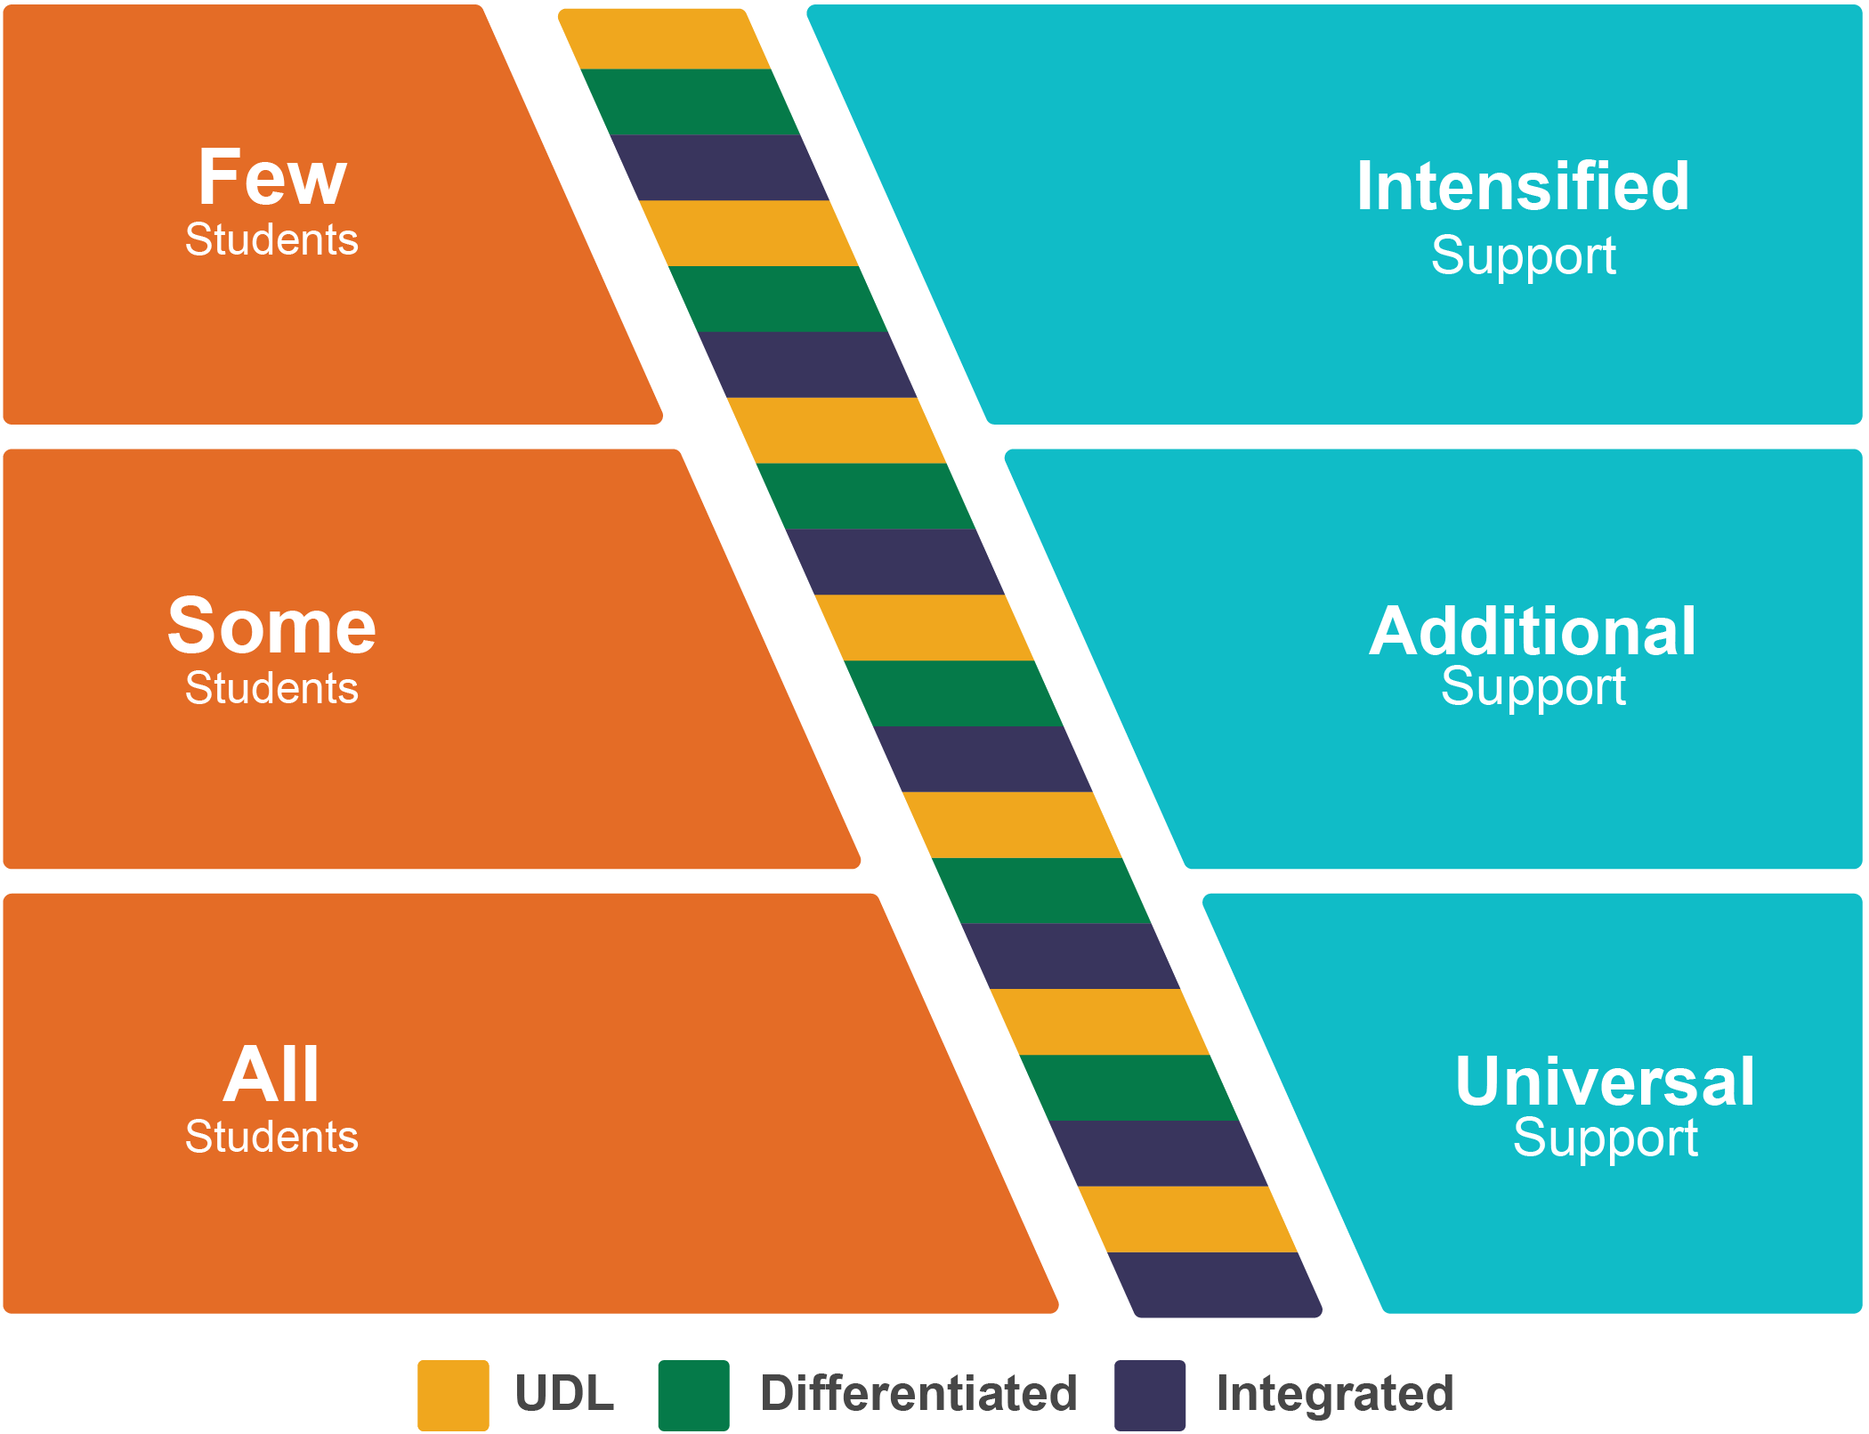
Notes:
MTSS allows us to create one system for all students involving a continuum of supports. This visual emphasizes how we create our system with a focus on universal supports that are provided for all students, how we make sure additional support is provided for some students when necessary, and how intensified supports are customized for individual students as needed. Our focus is on how we attend to academic, behavioral, and social-emotional needs of the whole student emphasizing evidence-based practices and use of data to inform decisions.
The braiding down the middle represents how Universal Design for Learning, Differentiation, and an integrated approach applies to the entire continuum.

Slide 8
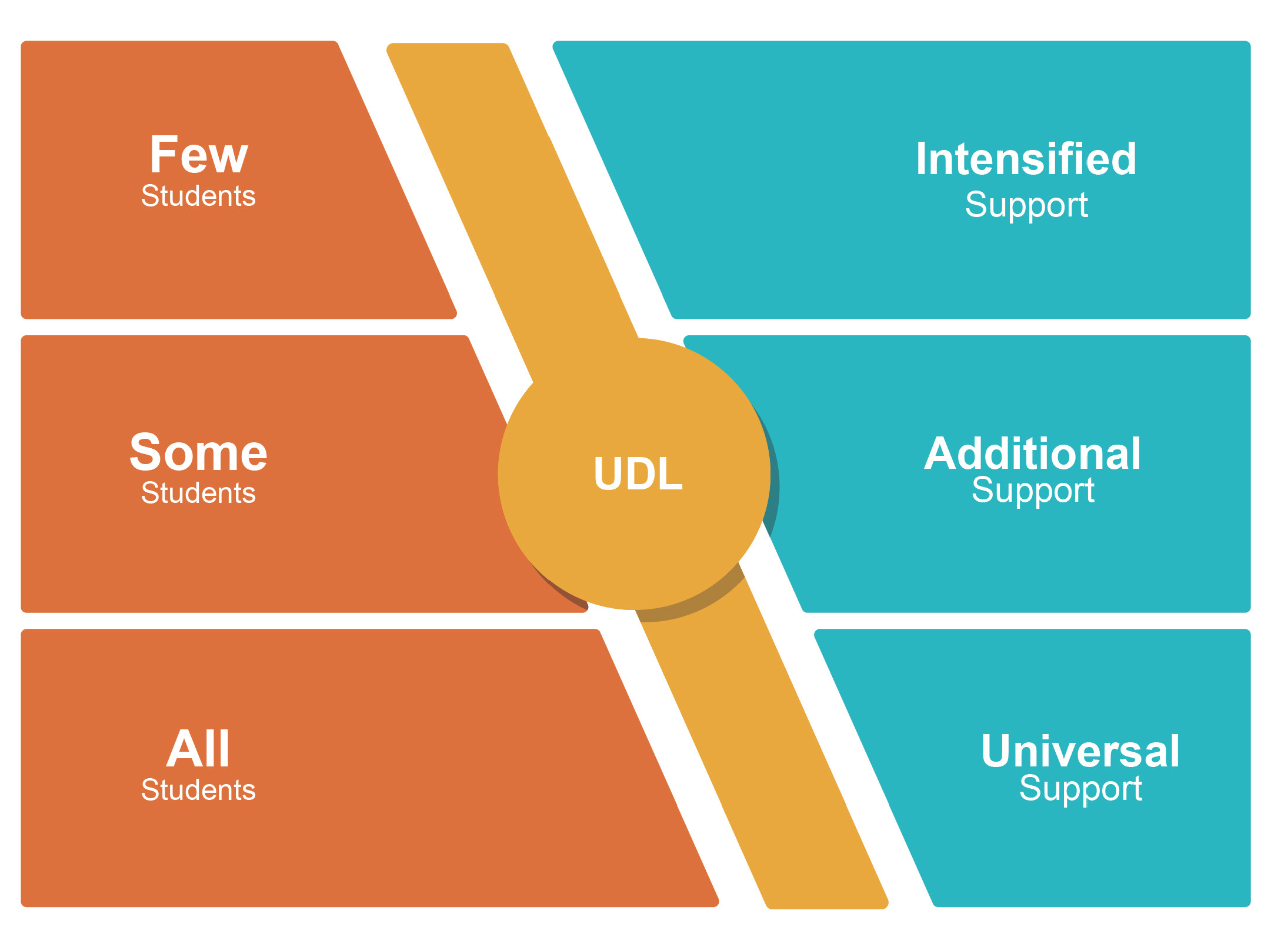
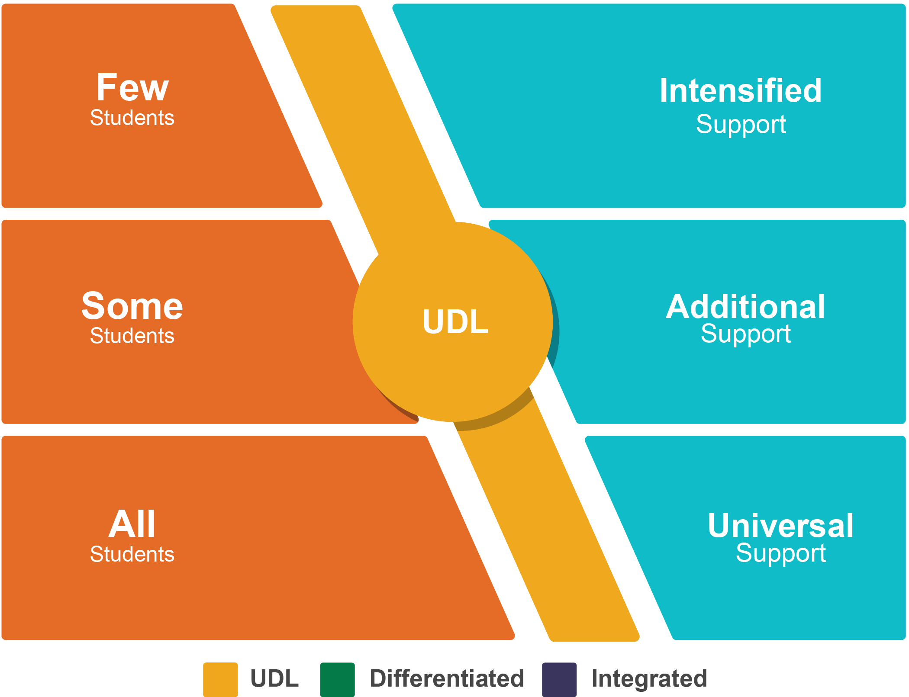
Notes:
Universal Design for Learning, or UDL, is Implemented at all levels of support and is designed to allow for variability within instructional strategies so that ALL students have the opportunity to learn through differentiated content, processes, and product. UDL integrates instructional differentiation and intervention support so that systemic changes are sustainable.
An important principle of UDL is that we expect and plan carefully for variability – (dawn jumps in bowling example)
An important UDL concept is “teaching to the margins.” This means that it is better to plan for the students within a class who are gifted, as well as those
with extensive support needs, because then we get everyone in between. As David Rose says, when we teach to the fictitious “average student,” we really aren’t teaching to anyone. MTSS provides an effective, useable, research-based framework for planning and delivering on “teaching to the margins.” The SWIFT website has a variety of resources to help facilitate this work.
emphasize UDL at all tiers—design for variability
If there are questions:
More info for participants:
UDL-
Multiple Means of Representation: “HOW” activity and content are presented
Multiple communication forms
Support ALL styles of learning- auditory, kinesthetic or tactile, and visual
Multiple complexity levels
Provide concrete information to explain concepts
Stating and defining
Repeating and restating
Concrete steps or discrete components
Multiple Means of Engagement: The “WHAT” of learning
Gaining children’s interest
This is the reason children want to participate and it requires deliberate planning
Balance between novelty & familiarity
Provide choice
Follow child’s lead
Connect prior experience to make it ‘real’ to children
Maintaining children’s interest
Use effective developmentally appropriate strategies for maintaining attention
Noticing, positive feedback, encouragement, and scaffolding
Organized activities
Large group, small group, and individual learning times
Multiple Means of Expression: The “WHY” of learning
Multiple acceptable formats for making responses
Be flexible and allow for children to interact using their strengths, learning styles, needs, and preferences
Verbal
Gestures
Pointing
Drawing
Writing
Multiple acceptable levels of complexity of responding
Reflect different preferences, strengths, and abilities in activities
Scaffolding
Prompts
Positive guidance
Modeling

Slide 9
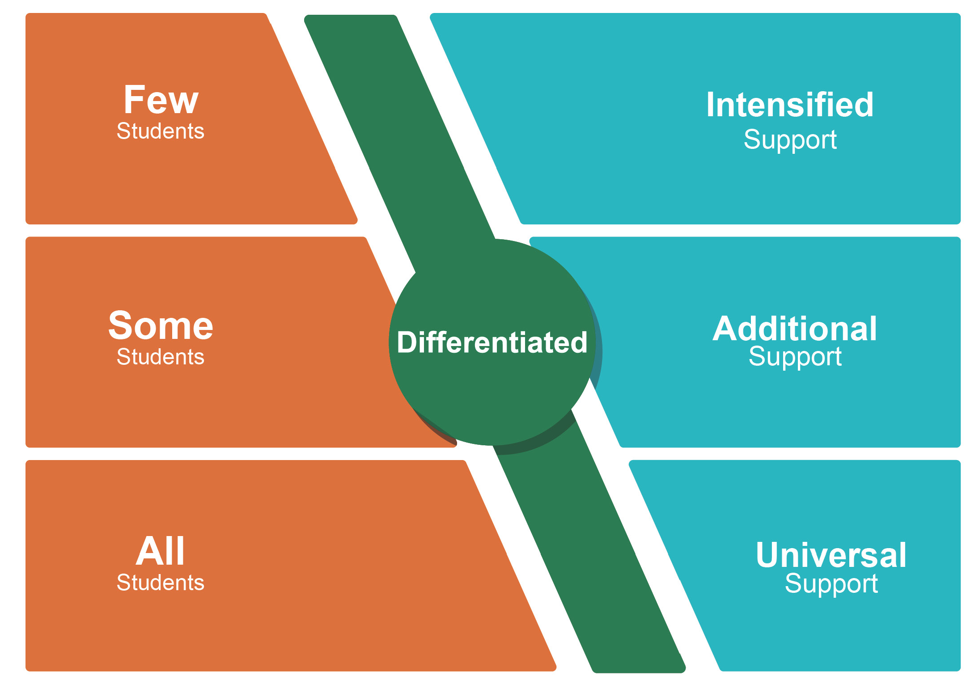
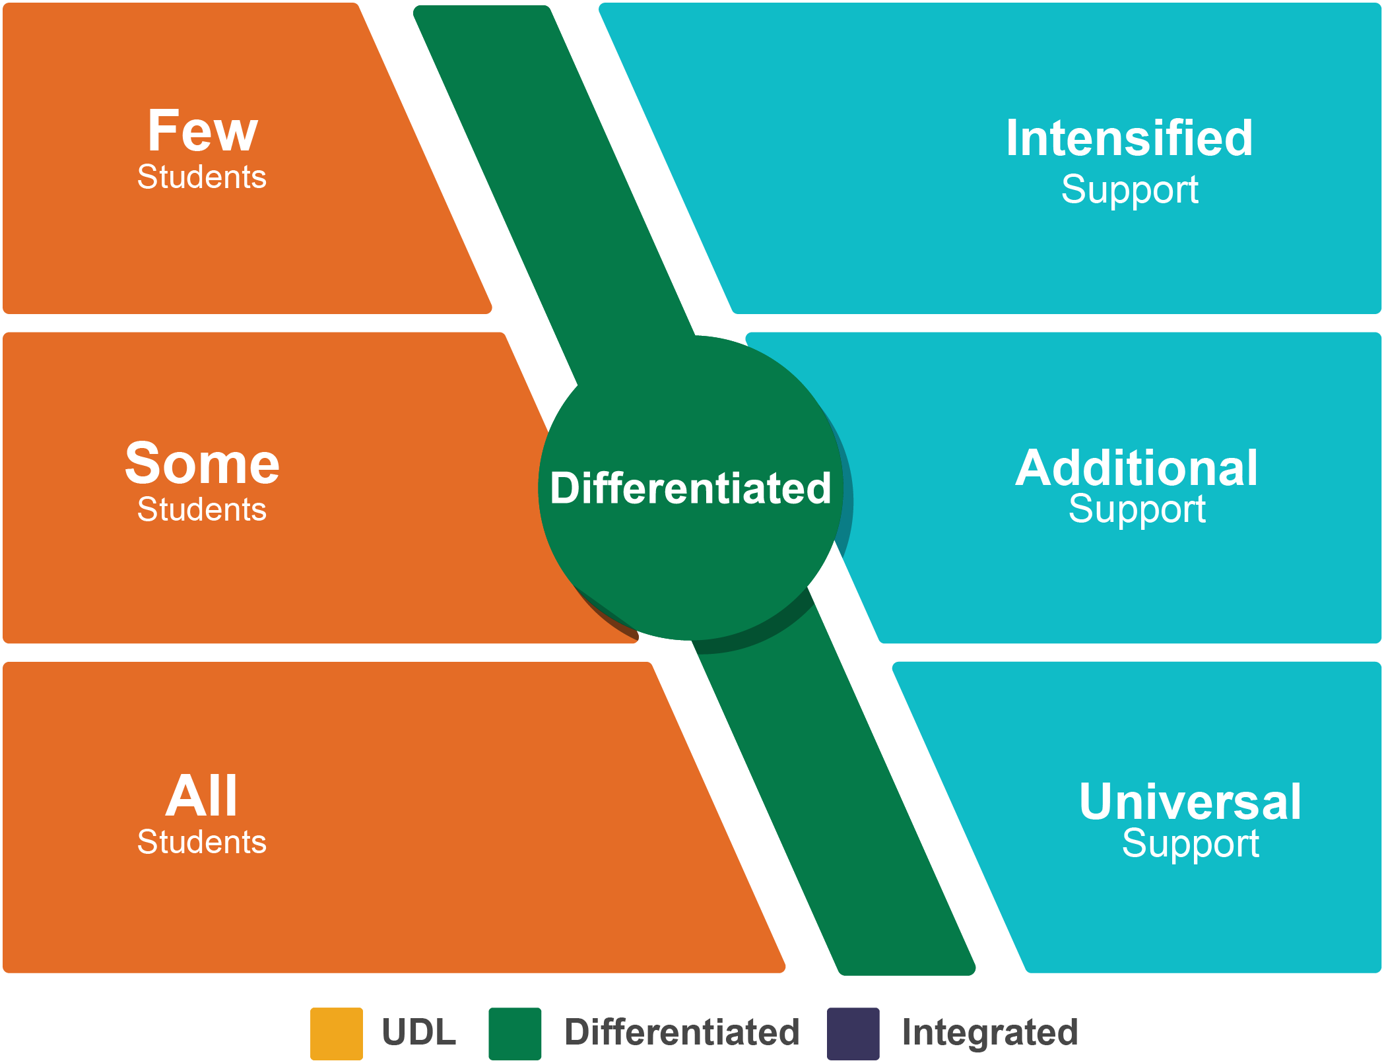
Notes:
Differentiated instruction will benefit all students and the varied learning needs and abilities that they possess in order to maximize learning. As we deepen our understanding based on our observations and data, we are able to make adjustments accordingly to meet their individual needs.
emphasize Differentiated instruction at every tier for the particular students in a given school

Slide 10
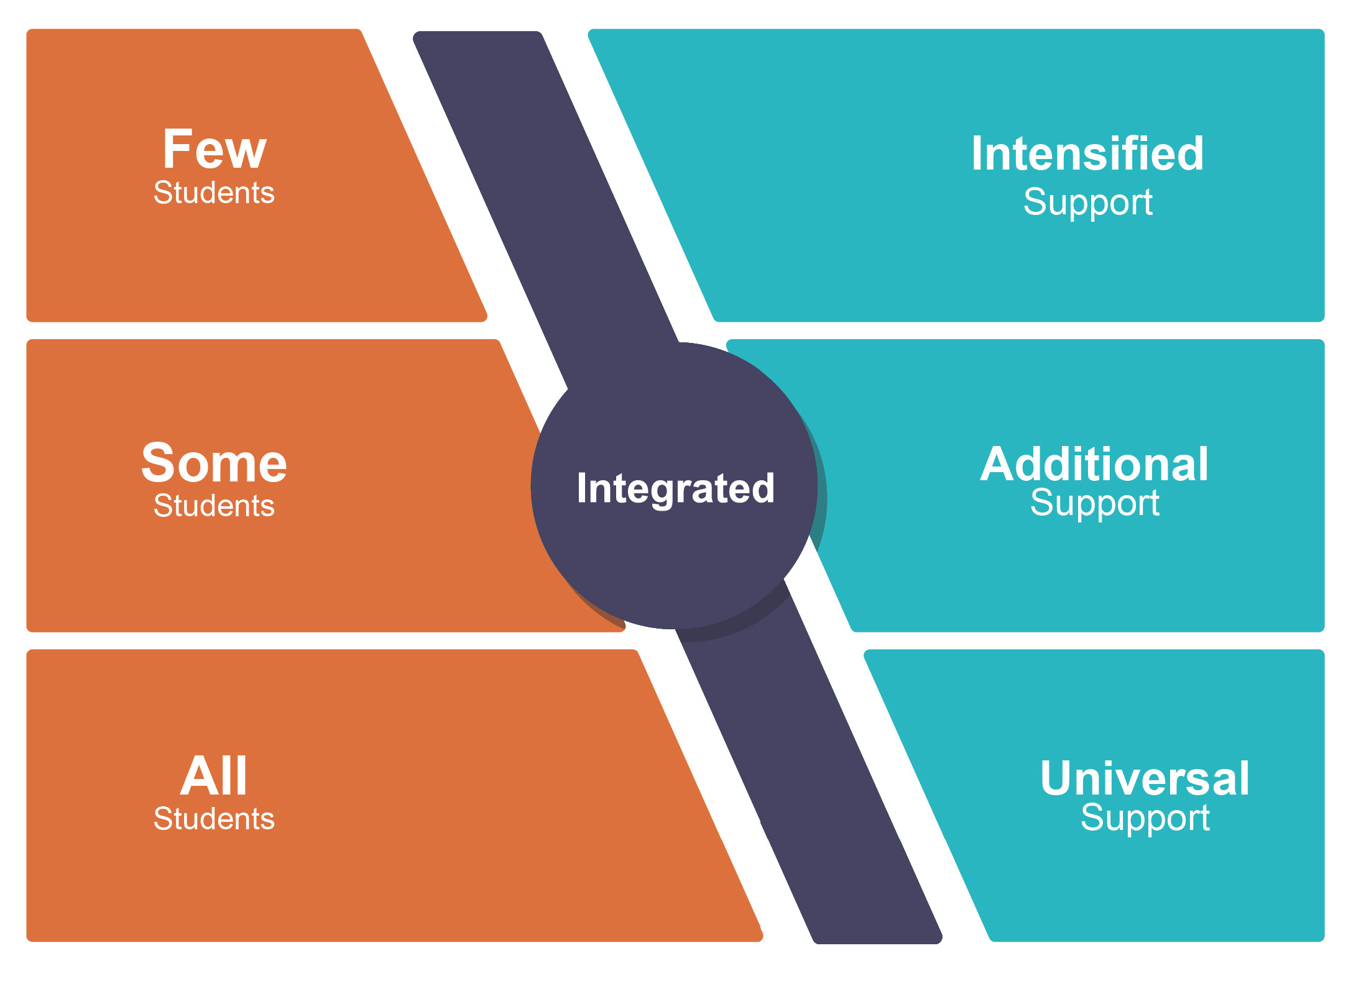
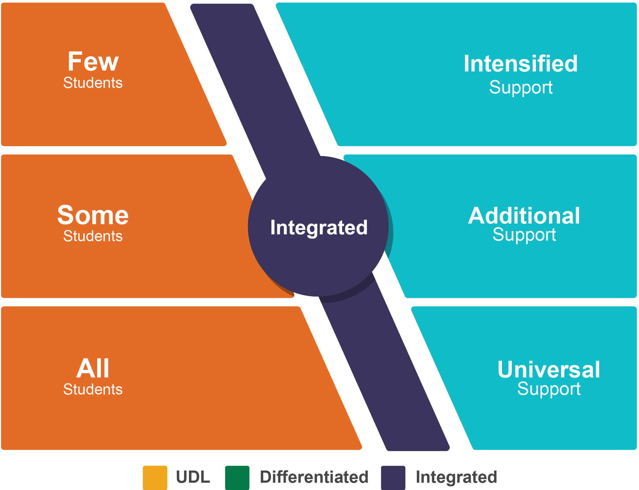
Notes:
Integrated Content and Service Delivery Systems are utilized across all levels of supports allowing for the opportunity to provide the best possible content and service delivery for ALL children with varying levels of abilities and need across all levels of support.
We also view integration from the lens of ensuring we understand behavioral, academic, and social emotional needs so integrated plans can be made that address the whole child.
emphasize integrated content and service delivery (vs silos, separate academic, behavior support) at every tier

Slide 11
Notes:
UDL, Differentiation, and Integration are then braided together and utilized as one continuum of services for all students across all levels of support.
This is our focus as we go into resources on the SWIFT Guide
Verbally share that we draw attention to the core features of how data and evidence-based practices need to be articulated across the system

Slide 12
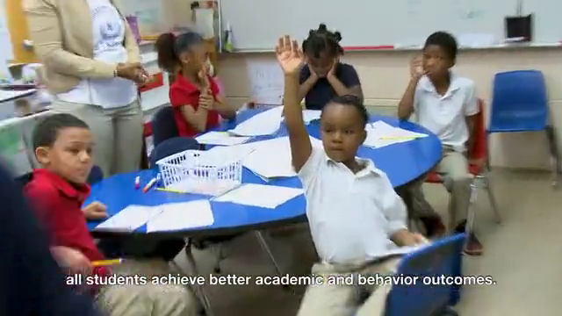
MTSS: What Does It “Look” Like?

Slide 13
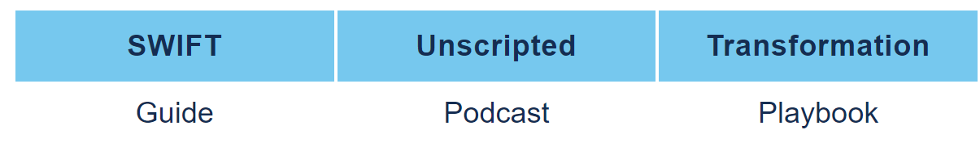
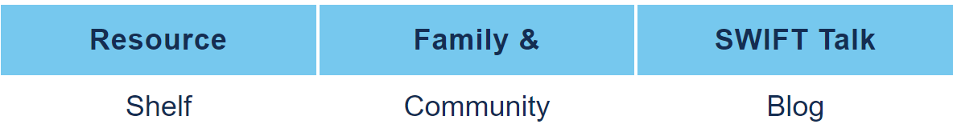
SWIFT Resources
Notes:
SWIFT is not a new initiative or something extra that you have to “do.” It is a national technical assistance center that offers resources to make your job easier as you implement MTSS within your setting. The SWIFT website has a variety of resources to help facilitate this work.

Slide 14
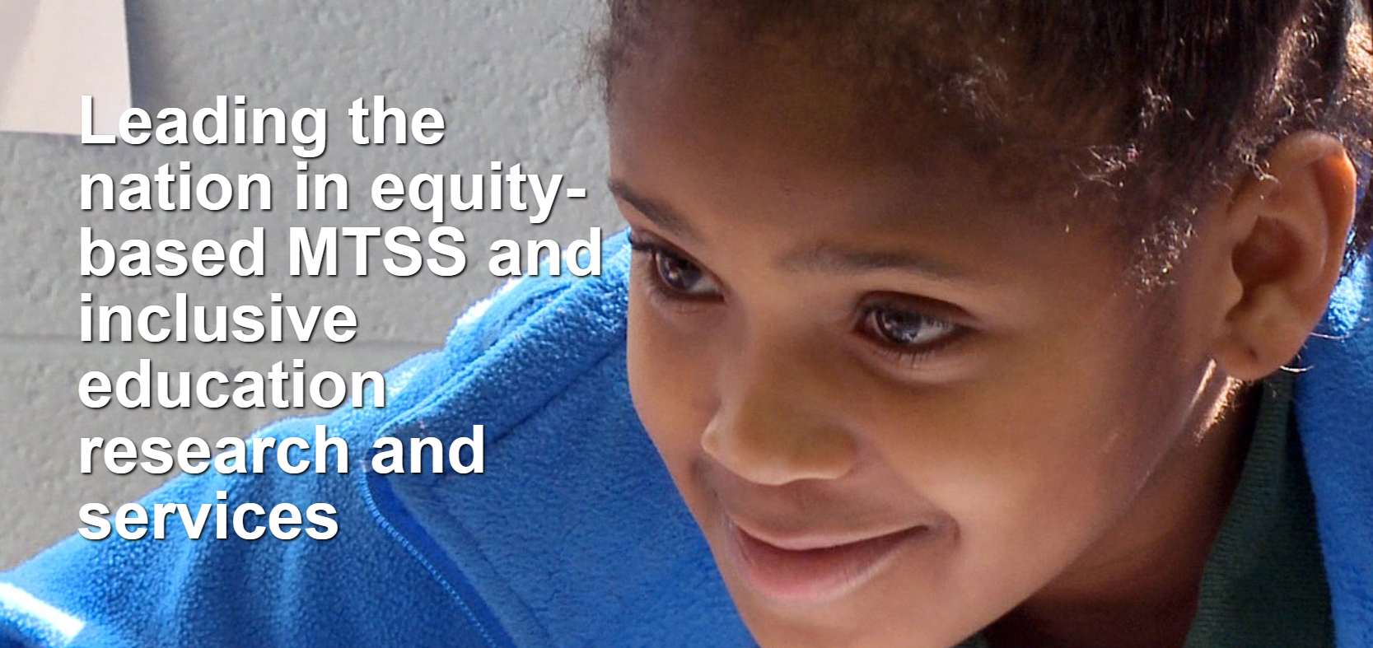
http://www.swiftschools.org/
Notes:
Take through SWIFT Guide – live
Go to Academic Inclusive Instruction and show MTSS Starter Kit under resources

Slide 15
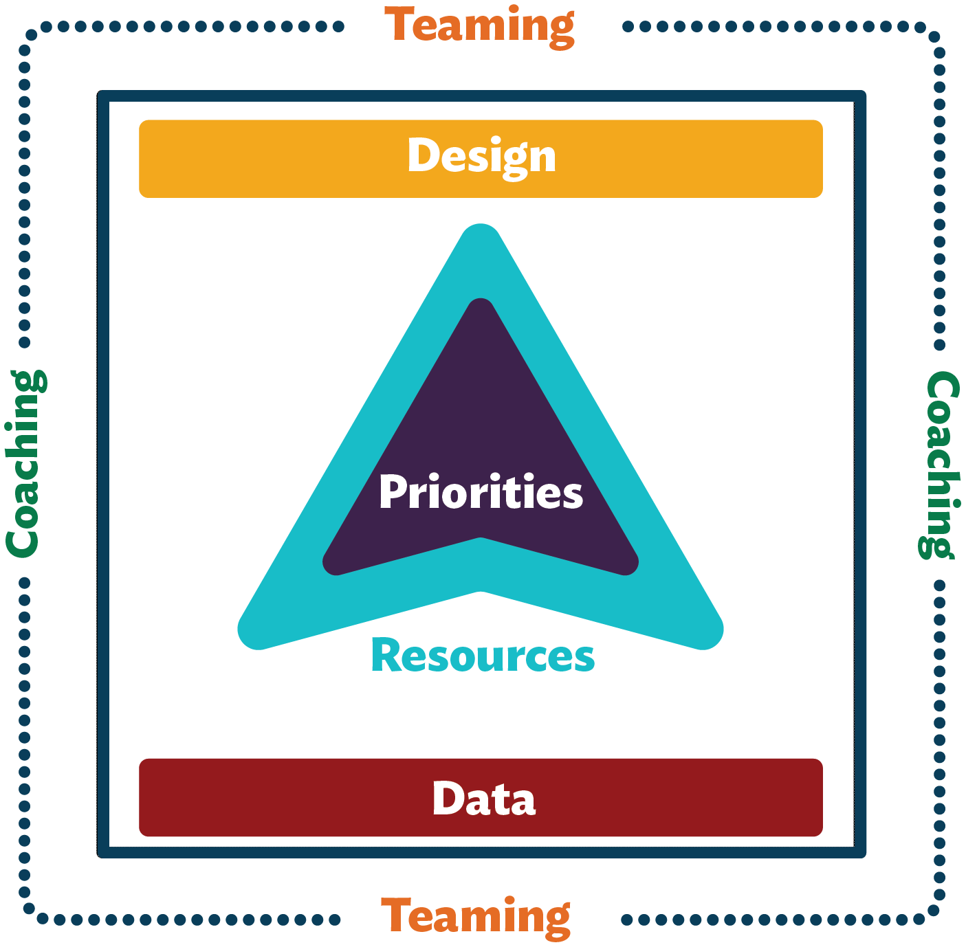
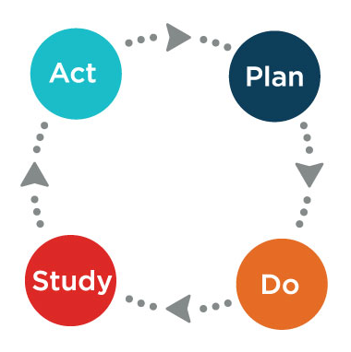
The “How” of Transformation
Notes:
3 min
The “how” of transformation has a focus on what we have learned from implementation research and literature.
Our Transformation in Action Practices, or TA Practices, help teams:
• create and articulate their ideal system through the Design practice,
• analyze student outcome, implementation, and capacity data by mining for strengths and generating opportunities to determine priorities,
• systematically understand practices that will help achieve priorities, carefully prepare people and systems for implementation, and use a positive approach to evaluating implementation efforts and
• Identify and leverage resources to support implementation efforts within a district, community, state, and those available nationally.
Each of these has resources available to you in what we call the SWIFT Transformation Playbook

Slide 16
SWIFT Resources

Slide 17
http://www.swiftschools.org/
Notes:
Take through SWIFT Playbook- live
Discuss All areas but focus in on Resource Mapping and Matching- Show District form
Then go to the Resources and show the SWIFT-FIA or Fidelity Integrity Assessment:

Slide 18
SWIFT Resources
Notes:
Then go to the Resources and show the SWIFT-FIA or Fidelity Integrity Assessment:
SWIFT Fidelity Integrity Assessment (SWIFT-FIA) is a self-assessment used by School Leadership Teams to examine the current status of schoolwide practices that have been demonstrated through research to provide a basis for successfully including all students who live in the school community. School-based teams can administer SWIFT-FIA through a structured conversation accompanied by a review of evidence to substantiate the ratings assigned. By assessing the extent of current implementation of SWIFT Core Features during the school year, teams can monitor their progress over time.
There is also an opportunity for districts to contract with SWIFT to come out to your schools to conduct a SWIFT- FIT, which is a SWIFT Fidelity of Implementation tool or to train others to complete it with fidelity as a trained and reliable assessor. The SWIFT-FIT provides a research-quality assessment of the extent to which a school is implementing the SWIFT framework of inclusive education. Trained evaluators working with school and community personnel administer the SWIFT-FIT. The results from the SWIFT-FIT document the extent to which a school is implementing SWIFT features and help to guide action plans for installing SWIFT practices. Contact the SWIFT Education Center for more information.

Slide 20
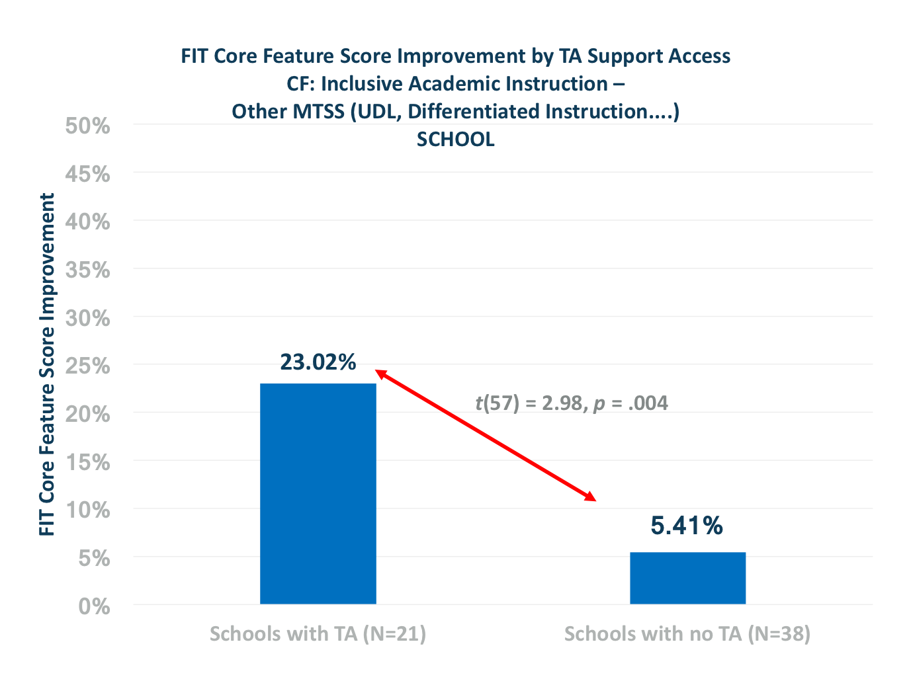
TA Across all SWIFT OSEP Partner States

Slide 21
Correlation Between PARCC and FIT –
MS Partner Districts

Slide 22
Opportunities
Use Free Web-based Resources
Mississippi Early Childhood MTSS Implementation training series
  Connect with SWIFT team at Summer Head Start Conference, July 15-20
Send Inquiries for Support to swift@ku.edu

Slide 23


Slide 24
Grazie
Merci
Gracias
THANK YOU
Spasiba
Danke sehr
Arigato
Notes:
Thank you!

Slide 25
SWIFT Education Center, a technical assistance center of the Life Span Institute at The University of Kansas, produced this presentation. Please contact swift@ku.edu for permission to reproduce it in whole or in part, and cite as: SWIFT Education Center. (2018). Implementation resources for MTSS in Mississippi schools [webinar].
© SWIFT Education Center, 2018.

