Slide 1
Tapping the Potential of Parents: Moving Beyond Family Involvement “Activities” to Authentic Engagement
By: Dr. Patricia Edwards
Edited by: Tammy Kirkland, NBCT

Slide 2
Please, Note
This presentation does not include sound other than two short embedded videos
This presentation is on a timer. The timer is set to 12 seconds for each slide.
This presentation can be watched as a video or you may download the PowerPoint.

Slide 3
Presentation Objectives
Who Are Your Students and Parents: State, School, and Class Demographics
Getting to Know your Parents and Students on a Personal Level: Maslow Rules
Parental Involvement Strategies: Engagement in the 21st Century
Action Plan

Slide 4
Know Your State

Slide 5
Public School in Mississippi Mississippi Department of Education, 2017
Students in high minority and high poverty districts are disproportionately taught by inappropriately licensed teachers
Students in high poverty schools are disproportionally taught by inexperienced teachers (0-3 years experience)
Student Race: White 44%, Black 48%, Hispanic 4%, Other 4%

Slide 6
Poverty, MDE

Slide 7
Education
50% of MS teachers leave the profession within the first 5 years of teaching
MS has a significant shortage of teachers and administrators
(2014) 2/3 of MS kindergarteners scored below the benchmark associated with 70% mastery of early literacy skills.

Slide 8
Achievement Gap Analysis

Slide 9
Data Sources
MDE, MS Equitable Access Plan
MDE, Enrollment Report
MDE, Assessment Achievement Gap Analysis
Talkpoverty.org

Slide 10
Questions to Ponder: What is knowing this data and information about your school important and necessary? Action Step: Research the data for your school.

Slide 11
What does it take to produce a successful student?

Slide 12
Challenges Facing Schools and Families
Achievement Disparities
Opportunity Gaps
Meaningful Home/School Engagement
Societal Pressures
Diverse Perspectives About Parent – Teacher Role

Slide 13
Barriers to School-Family Partnerships
Families’ disconnection to the school community
Communication differences
Lack of information about school expectations, programs and resources
Family isolation

Slide 14
Schools are communicating with a variety of parent groups
Unwed teenage mothers
Two-parent homeless families
Single-parent families
Stepfamilies
Working mothers
Foster families
Grandparents
Incarcerated parents

Slide 15
Schools are communicating with a variety of parent groups
Non-traditional families
Two-parent families
Low-literate parents
Culturally diverse parent groups
Extended, reconstituted or blended families
Unemployed parents

Slide 16
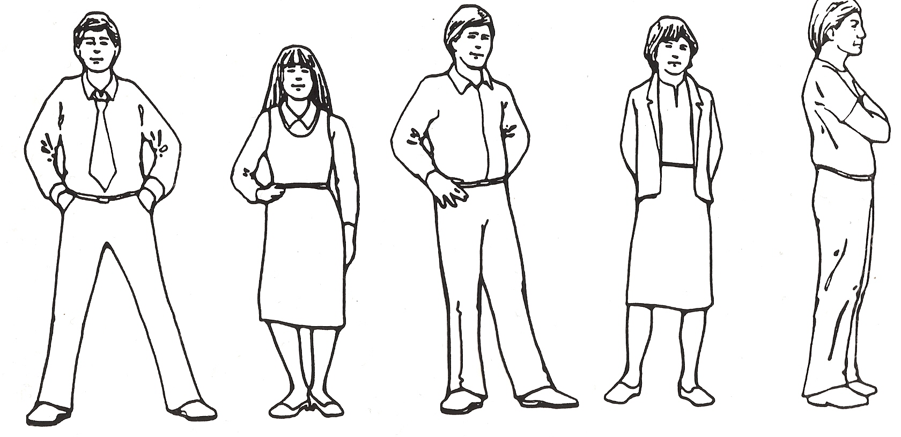
Parents respond to schools based upon past experience and the current situation
Parents who avoid schools like the plague
Parents who need encouragement
to come to school
Parents who readily respond when invited to school
Parents who are comfortable and enjoy involvement in school
Parents who enjoy
Power and are overly active

Slide 17
Questions to Ponder: Sometimes unintentional bias may exist. If you do not agree with the life style or decisions of a family, does it affect your interaction with that student and his/her family? Action Step: How can you safe guard again unintentional bias?

Slide 18
Remember
Not all students have a mother and father at home. Some are being raised by Grandparents, Aunts/Uncles, or are in Foster Care
ALWAYS use the term: Parents/Guardians when sending information home

Slide 19
Whose job is it, Anyway?
This is a story about four people named Everybody, Somebody, Anybody and Nobody. There was an important job to be done and Everybody was sure that Somebody would do it. Anybody could have done it, but Nobody did it. Somebody got angry about that, because it was Everybody’s job. Everybody thought Anybody could do it, but Nobody realized that Everybody wouldn’t do it. It ended up that Everybody blamed Somebody when Nobody did what Anybody could have.
The story may be confusing but the message is clear: no one took responsibility so nothing got accomplished.

Slide 20
Culture IS an Issue
Culture is a social construct, not genetic, and most students have at least three: home, peer, and school. The language and behaviors for each one is different, and for many students, the language at home is so divergent that entering school is like going to a foreign country and speaking a new language. For example, students may come from a home in which children are told to be seen and not heard, so speaking up and participating in class seems wrong to them. Or, what some teachers see as a behavior disorder is just the contrast between the culture at home and at school. – Stacy Pusey

Slide 21
The Cultural Iceberg
CULTURE
Dress - Food
Games - Music
Artifacts - Literature
Surface
Deep Waters
History geography
Language -dialects
Gender Roles
Status / class
Concept of time
Values
Religion
Communication styles
Beliefs
Political history/climate
Norms
Attitudes
Formality / informality
Education System
And more . . .
Family/community/tribal systems
Just as nine-tenths of an iceberg is below the waterline & out of sight, nine-tenths of culture is below conscious awareness.
Notes:
3

Slide 22
Questions to Ponder: What issues might a student from a different culture face in your classroom or school? How would you even know it was an issue? Action Step: Research your students’ cultures if their culture is different from yours.

Slide 23
Why Learning to Work with Families is Important?
If we think about the worlds of many of the children in our nation’s classrooms, we might be overwhelmed by the fragmentation that takes place as they move from the hopes of their families and the promise of the early years through an educational system that gradually disconnects their lives. (Taylor & Dorsey-Gaines, p. 224)

Slide 24
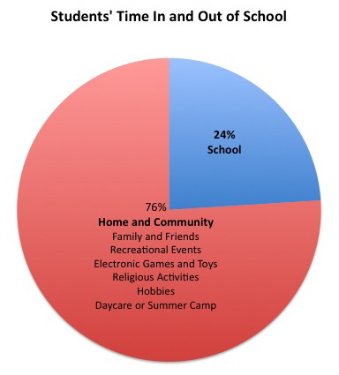
Students’ Time In and Out of School

Slide 25
Teacher Education
“Many teachers find themselves ill-prepared to comprehend the multiple cultures that students bring to the classroom, let alone bring dignity and respect for those cultures. They are taught subject matter, but not what to do when the subject matter does not pertain to the life experiences of the students. Teacher education programs rarely prepare teachers to make education meaningful to diverse groups of students” (Krevotics & Nussell, 1994, p. xi).

Slide 26
Why Develop a Scope and Sequence of Parent Involvement?
Capitalize on the curriculum as a means of communicating with parents. It is an ongoing way to keep parents totally informed of their child's day, the school's goals and objectives…It's one way to begin to establish close, meaningful communication with busy parents... (p. 25)

Slide 27
Developing a Scope and Sequence of Parent Involvement: Some Advice
Folk theories about students and families
Cohesiveness of your instructional network
Developing a shared vision

Slide 28
Sample of a Scope and Sequence of Parent Involvement
Kindergarten – Sharing Time
First Grade – Emergent Literacy
Second Grade- Reading and Writing Connections
Third Grade– Writing Process
Fourth Grade- Content Area Reading
Fifth Grade – Content Area Reading

Slide 29
Questions to Ponder: How can you communicate with ALL the families represented in your classroom? What factors prohibit you from communicating with all families? Action Step: Develop a list of prohibiting factors and schedule a meeting with your school counselor. Seek their help and advise.

Slide 30
New Ways to Engage Parents/Guardians

Slide 31
Develop a Demographic Profile
The simplest and quickest way to do this is just to ask your students the following questions about their parents/guardians
Who do you live with?
Do they work? If so, where?
Day shift or night shift?
Where do you get off the bus?
Does anyone help you with your homework? If so, who?
Do your parents/guardians speak English?

Slide 32
Creating a Demographic
Helps you understand who your students are
The needs of your students
Assists you in determining the best type of communication
Who are your parents/caregivers? Understanding their situation will assist you to provide beneficial help to their children. (see Parent Stories video)

Slide 33
Parent Stories

Slide 34
Before you proceed, know the following
Do not ever make a home visit alone?
Does your school have any policies on contacting parents?
Be mindful that if you make a call from your personal cell phone, the parent has your number and can call/text you at will.

Slide 35
Questions to Ponder: What do you know about your students’ families? What sort of information would like to collect? Action Step: Create a parent inventory based on your response above and send it home to your parents.

Slide 36
Making the Most of Your Community
Identify the resources that are available to support children’s learning in the community and share this information with parents. Examples:
After school clubs
Religious organizations
Volunteer and Community Groups: Delta Kappa Gamma, Rotary, Junior Auxiliary…etc.
Free Clinics
Library
Create a Community Directory and share with students and parents.

Slide 37
Methods of Engagement
Engaging in Person-to-Person Interactions
Using Technology to Communicate
Bringing Parents Together Around Things that Matter
Meet Parents Half-way and Have a Way to Meet Every Parent
Overcome the Ghosts in the School and its Community
Models of Parental Involvement
A Paradigm Shift

Slide 38
Engaging in Person-to-Person Interactions Common Opportunities
Beginning of the year contact. Make a call or send a letter. (Lots of addresses will have changed. If the letter is returned to you, have it on the student’s desk so they will know that you tried.)
School Registration
Open House

Slide 39
Questions to Ponder: What steps can you take at the beginning of a new school year (or semester if you teach on a block schedule) to share information about your classroom with your students’ caregivers? Does your school have a registration? Do you make an initial phone call? Do you mail an introductory letter? Action Step: Choose a communication/introductory strategy that works best for you and implement it next year/semester.

Slide 40
Registration
Provide the parents with the following information
District Handbook (attendance policy, discipline policy…etc)
School Rules/Class Rules
Personal Contact Information (Phone, Remind, Email…there must be something)
Before School and After School Programs
Lunch Applications
Medical Forms
School Forms
How will the student get home? Bus, car, walker?

Slide 41
Open House
There is no way to predict when parents will come of if they will come. Often, they show up all at once. It can be overwhelming.
If you do not have an assistant, ask a friend or family member to help you out.
Have an assignment on the board (yes, for the family)! A classroom scavenger hunt is a great idea.
Make the time to speak to every parent/guardian. This is your opportunity to begin to get to know each other. Establish Communication.
Have a sheet where the parents sign by the student’s name (This will come in handy when you ask students to return papers signed. When in doubt of the authenticity of the signature, compare it with your sign in sheet. The school will ask for your sign in sheet. Provide the administration with a copy. You keep the original.)
Offer an incentive for parents to come: A homework pass or a daily grade of 100 usually will suffice.

Slide 42
Open House Scavenger Hunt Example

Slide 43
Parent – Teacher Conference
Provide parents with an update on their child’s progress
Discuss difficult situations
Set up early in the school year as a means for laying the foundation for two-way communication
Get to know the parent
Never meet with a parent alone. Ask either the assistant principal or counselor to join you.

Slide 44
Meeting with Parents, Another Idea

Slide 45
Parent – Teacher Conference
Be courteous
Be clear
Be helpful – Make sure they leave with something to help their child, a plan and resources.
If the parent called the meeting and is upset, let them speak first (after you’ve made all the introductions). Remain quiet even though you may feel defensive. If you do not allow them to “speak their peace” first, they will disrupt until they get their turn. Almost always there is a misunderstanding. Often, the child has not been truthful. Clarify the misunderstanding as professionally as you can.
Often, you may want the child to join you after you and the parent have spoken privately first.

Slide 46
Additional Opportunities
Class get together after school hours. Students are NOT allowed to be dropped off (You are not a baby sitter!). Encourage families to bring other siblings.
This type of opportunity builds classroom community
Meet at a ballgame, a park, or visit an event together. Visit the library together and get library cards and check out all their resources.
Let your principal know you are doing this; although, it does not require permission.

Slide 47
Types of Communication
One way strategies - keep parents informed about activities and school policies
Two way – an integral part of building partnerships with parents. Allows for the exchange of ideas including information on assessment and instruction to build productive partnerships.
True partnerships with parents/families can only be achieved when two-way communication strategies are utilized.

Slide 48
One Way Communication
Newsletter
Report cards/progress reports
Handbooks
Graded work & assessments
Text messages
Websites
Automated phone calls

Slide 49
Two Way Communication
Parent surveys
Report cards/progress reports/newsletters that provide a space for parents to communicate through written notes
Twitter/Remind if the option is chosen for parents to reply
Classroom Facebook pages
Phone calls
Emails

Slide 50
Using Technology to Communicate w/Families
Remind
Voice Mail
Email
Texting
Edmodo
Skype/Google Hangouts/Zoom (Excellent for conferences)
School websites
Class Websites
Instagram/Twitter
Blogs/Wikis
App List
Website List

Slide 51
Bringing Families Together Around Things that Matter
Parent Informant Meetings
Literacy Night
Math Night
Show parents what success looks like. Provide resources for families. Do NOT assume the parents can help the students.

Slide 52
Meet Parents Halfway, and Have a Way to Reach Every Parent

Slide 53
Parents Differ in Many Ways
Parental/Family Dynamics
Parent feelings regarding school
Parent relationships with their children
Parent values and goals
Parent attitudes toward involvement with the school

Slide 54
Strategies to Get Parents Comfortable Talking
Connect parents with other parents who have similar needs
Provide a suggestion/comment box
Provide a translator for parents who cannot speak English
Keep a communication log to see who you are and are not communicating with and what are you are communicating about

Slide 55
Sample Communication Log

Slide 56
Questions to Ponder: How do you regularly communicate with your students’ families? Do you regularly communicate? Is your communication one-way or two-way? Action Step: For two weeks, keep a communication journal. Who do you talk to? Do you contact them or do they contact you? Do you make a phone call, schedule a conference, or send a email. Is your communication only about behavior? Is your communication negative or positive? Analyze your results and take action.

Slide 57
Don’t Blame Families
A common misperception about families who are not actively involved at school is that they simply, “don’t care about their children’s education.”
Building trust by examining and addressing these barriers and obstacles is more likely to lead to higher levels of family involvement.
White, higher-income families tend to be more visible in many schools.

Slide 58
Develop an Action Plan

Slide 59
What to do with all the data?
Use the data to drive your instruction, plan remediation and enrichment activities, and to help plan assessment.
WARNING: Do NOT just read it and put it away.

Slide 60
Data Notebook
Each year, crate a data notebook for your class. (If you have multiple classes, you’ll need a notebook for each class.)
1st page has all students listed and any major health issues indicated or ruling out beside their name.
2nd page should be your communication log.
Partition the notebook for each student.
Each student should have the following information: a copy of their health sheet (this will provide emergency contact information), learning styles inventories, interest inventories, test data, and data collected from parents
Your notebook may not contain all of these data items, but the idea is to collect and assemble as much data as you can about each student.
*It is ideal to create this notebook at start of the year, but the important thing is to create it.

Slide 61
Recap
Gather data on your students (quantitative and qualitative). Know who they are and where they are.
Gather data from your parents. Know who they are and their expectations for their child.
Build a relationship with parents
Use two-way communication
Utilize technology

Slide 62
Books by Dr. Patricia A. Edwards
New Ways to Engage Parents: Strategies and Tools for Teachers and Leaders, K-12 (2016)
Bridging Literacy and Equity: The Essential Guide to Social Equality Teaching (2012)
Change is Gonna Come: Transforming Literacy Education for African American Children (2011)
Taping the Potential of Parents: A Strategic Guide to Boosting Student Achievement through Family Involvement (2009)
Children’s Literacy Development: Making it Happen through School, Family, and Community Involvement (2004)
A Path to Follow: Learning to Listen to Parents (1999)

