Slide 1
Students and the Juvenile Justice System: a trauma informed Court
Hon. Hallie Leavell, Referee,
Juvenile Court, Sixth Judicial Circuit

Slide 2
Juvenile Court
Delinquency:
An act committed by a child that is designated a violation, misdemeanor, or felony offense pursuant to the law of the municipality, county, or state in which the act was committed or pursuant to federal law. Code of Alabama 1975, §12-15-102 (6).
CHILD IN NEED OF SUPERVISION. A child who:
Is habitually truant from school
Disobeys the reasonable and lawful demands of his or her parent, legal guardian, or legal custodian and is beyond the control of the parent, legal guardian, or legal custodian.
Leaves, or remains away from, the home without the permission of the parent, legal guardian, legal custodian, or person with whom he or she resides.
Commits an offense established by law but not classified as criminal.
Who do we serve

Slide 3
Dependent Child
A child …meets any of the following circumstances:
1. Whose parent, legal guardian, legal custodian, or other custodian subjects the child or any other child in the household to abuse …or neglect …or allows the child to be so subjected.
2. Who is without a parent, legal guardian, or legal custodian willing and able to provide for the care, support, or education of the child.
3. Whose parent, legal guardian, legal custodian, or other custodian neglects or refuses, when able to do so or when the service is offered without charge, to provide or allow medical, surgical, or other care necessary for the health or well-being of the child.
4. Whose parent, legal guardian, legal custodian, or other custodian fails, refuses, or neglects to send the child to school in accordance with the terms of the compulsory school attendance laws of this state.
5. Whose parent, legal guardian, legal custodian, or other custodian has abandoned the child.
6. Whose parent, legal guardian, legal custodian, or other custodian is unable or unwilling to discharge his or her responsibilities to and for the child.
7. Who has been placed for care or adoption in violation of the law.
8. Who, for any other cause, is in need of the care and protection of the state. Code of Ala.1975 §12-15-102 (8)

Slide 5
Trauma Informed Court
Trauma Informed is an organizational structure and framework that involves understanding, recognizing, and responding to the effects of all types of trauma.
Becoming “trauma-informed” means striving to recognize that people often have many different types of trauma in their lives.
Changing the questions we ask and the approach to take.

Slide 6
The Faces of Juvenile Court
Photos by Richard Ross
Photographer, researcher and Professor of Art at the University of California, Santa Barbara.
http://richardross/net

Slide 7
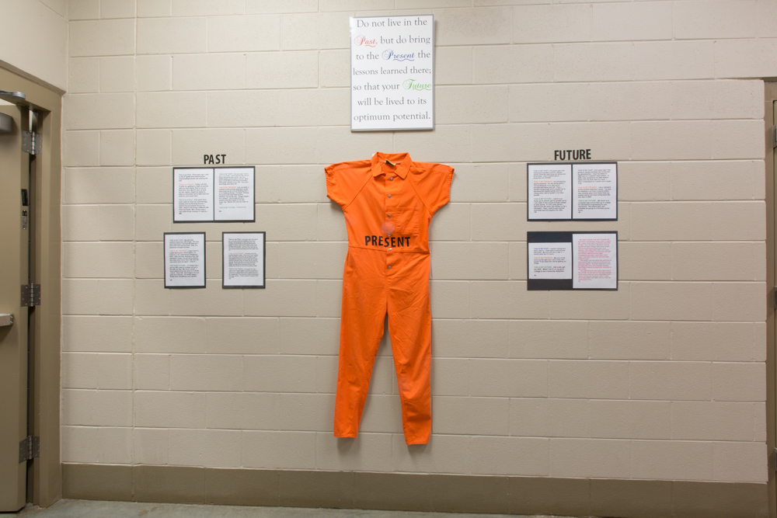

Slide 8
The Court Experience
Detention
Out of home placement
Out of family placement
Commitment
Placement disruption
Trauma from Inside the Courtroom

Slide 9
Impact of Court Involvement
Institutionalization
Educational disruption
Reentry
De-socialization
Loss of Normalization
Additional complications and implications of youth in Juvenile Court

Slide 10
Observations from the Bench
Integrate strength based approach
Mindful of method of conversing with children and families
Trauma Therapy and Trauma focused practices
Think creatively
Dealing with trauma impacted children and families in a courtroom setting

Slide 12
What works better
Alternative sanctions
Juvenile Detention Alternatives
Sanctions and Incentives grid
Strength and Weakness approach
Small Court settings
Alternative or deferred prosecution
Round Table Staffings (i-Can)
Trauma counseling:
Multi-systemic, Family Systems, EMDR, CBT, TST, and others

Slide 13
What we are trying
Human Trafficking Initiative
Deferred prosecution
Wrap around services
Trauma integrated therapy for youth with problematic and illegal sexual behaviors
PSB-CBT ( in conjunction with Youth Services Institute)
Family support and coordinated therapy with victim’s counselor
Trauma Systems Therapy
Intervention and organization model with trauma and safety component that allows child to be successful in therapy
Involvement from all systems: medical, educational, familial

Slide 14
What Not to do
Get Over it!
Talk them out of the experience.
It’s all your fault!
Focus on the negatives.
Get bogged down by disrespectful attitude.
Put your expectations on them.
Label or define by a failure.
Taboo practices when dealing with Children and Families with Trauma

