Slide 1
Unwrapping Structured Literacy and Why It Is Important For ALL Classroom Teachers
Dr. Katie Tonore, Ed.D

Slide 2
Dr. Katie Tonore, Ed.D
Dr. Tonore has over thirty years of classroom experience and has benefited from a variety of educational opportunities such as serving as literacy coach for the MS Department of Education, Director of Implementation for the Barksdale Reading Institute, graduate and under-graduate coordinator at the University of Southern Mississippi, educational consultant for the MS Center for Education Innovation, Bailey Education Group, CORE and Millennium Educational Systems.
Katie is the Chair of Curriculum and Instruction in the School of Education at William Carey University.

Slide 3
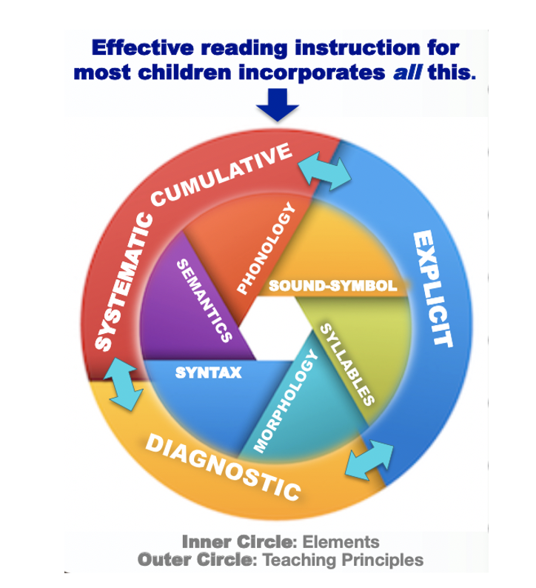
What is Structured Literacy?
“Structured Literacy is characterized by the provision of systematic, explicit instruction that integrates listening, speaking, reading, and writing and emphasizes the structure of language across the speech sound system (phonology), the writing system (orthography), the structure of sentences (syntax), the meaningful parts of words (morphology), the relationships among words (semantics), and the organization of spoken and written discourse.”
(IDA, Structured Literacy: An Introductory Guide, 2019)
Notes:
Refer to the “What is Structured Literacy?” Handout. Discuss definition then explain the graphic: Effective reading instruction for most children incorporates ALL this. The inner circle contains the elements that work together and the outer circle guides how the elements are taught.

Slide 4
Structured Literacy is an approach to reading instruction where teachers carefully structure important literacy skills, concepts, and the sequence of instruction, to facilitate children’s literacy learning and progress as much as possible.
This approach to reading instruction can be beneficial not only for students with reading disabilities, but also for other at-risk students including English learners and struggling adolescents.”
(Baker et al., 2014; Gersten et al., 2008; Kamil et al., 2008; Vaughn et al., 2006).

Slide 5
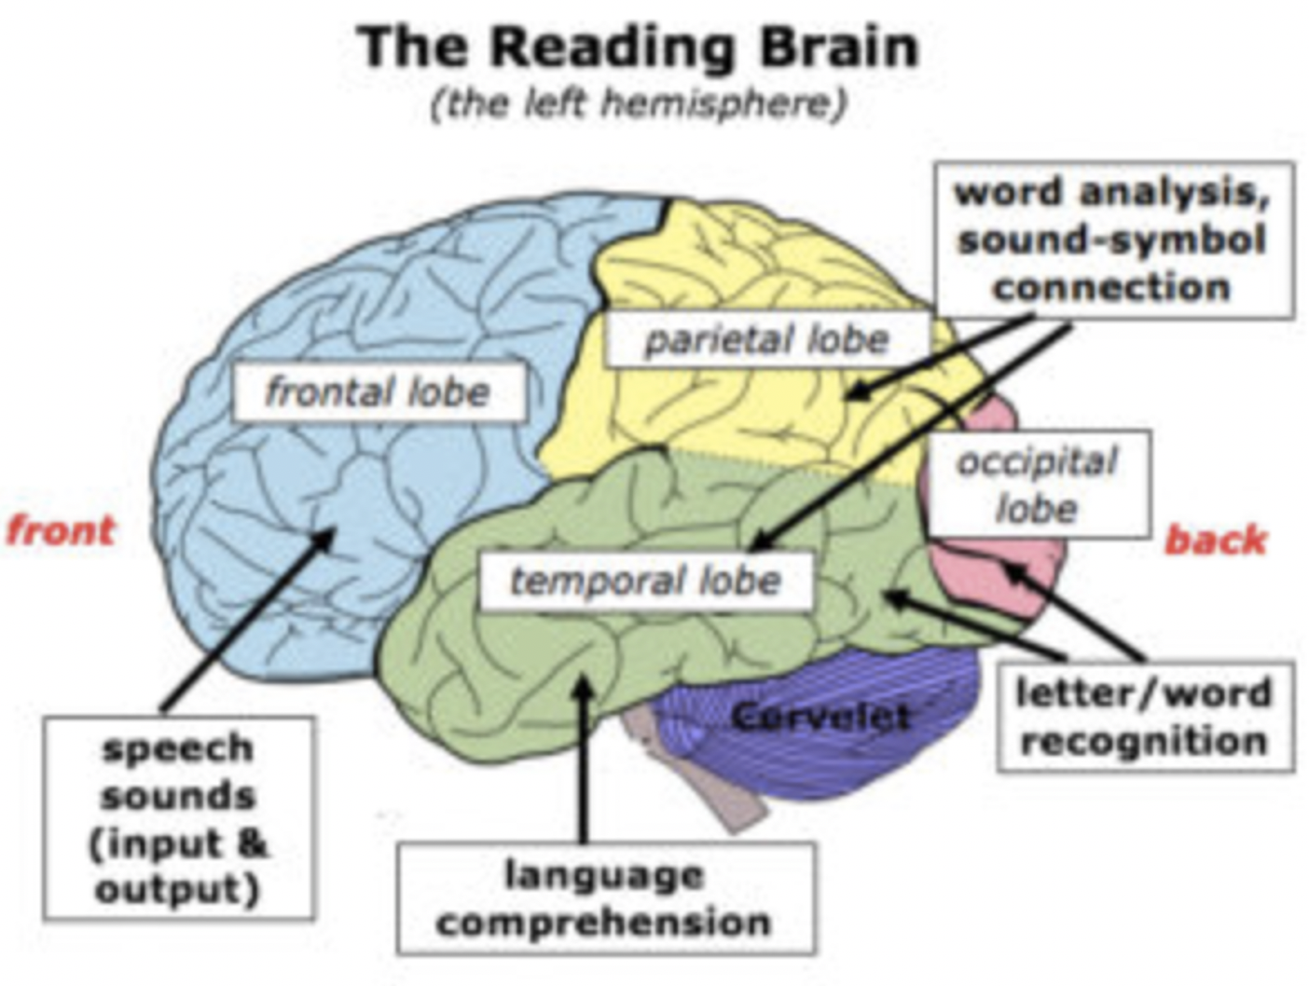
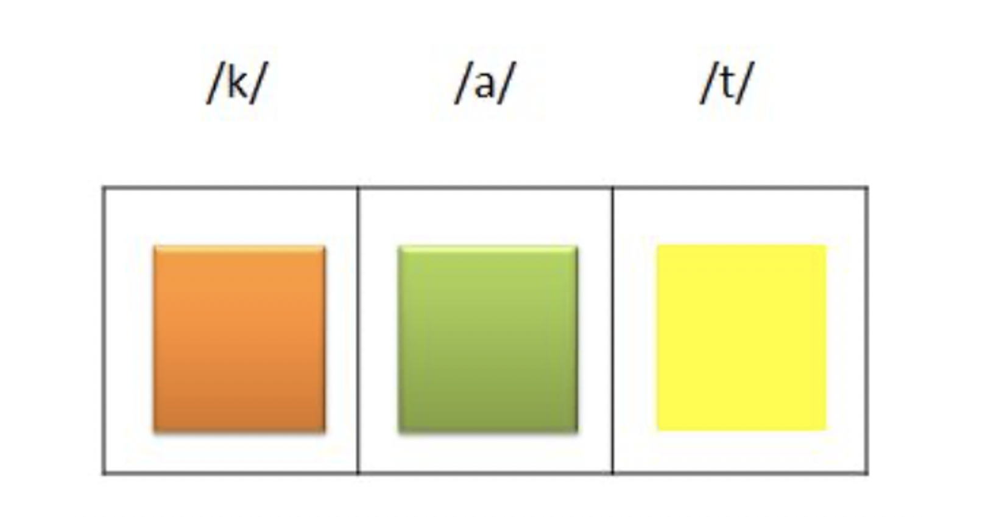
Phonology
The study of sound structure of spoken words
Phonemic awareness- ability to distinguish / segment / blend / manipulate sounds relevant to reading/spelling is central to phonology.

Slide 6
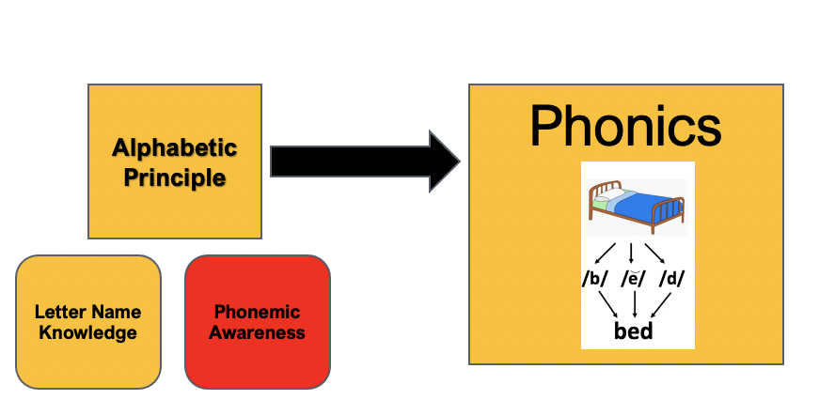
Orthography
Sound-Symbol Association- Once students are proficient in phoneme awareness, they must learn the alphabetic principle—how to map phonemes to letters (graphemes).

Slide 7
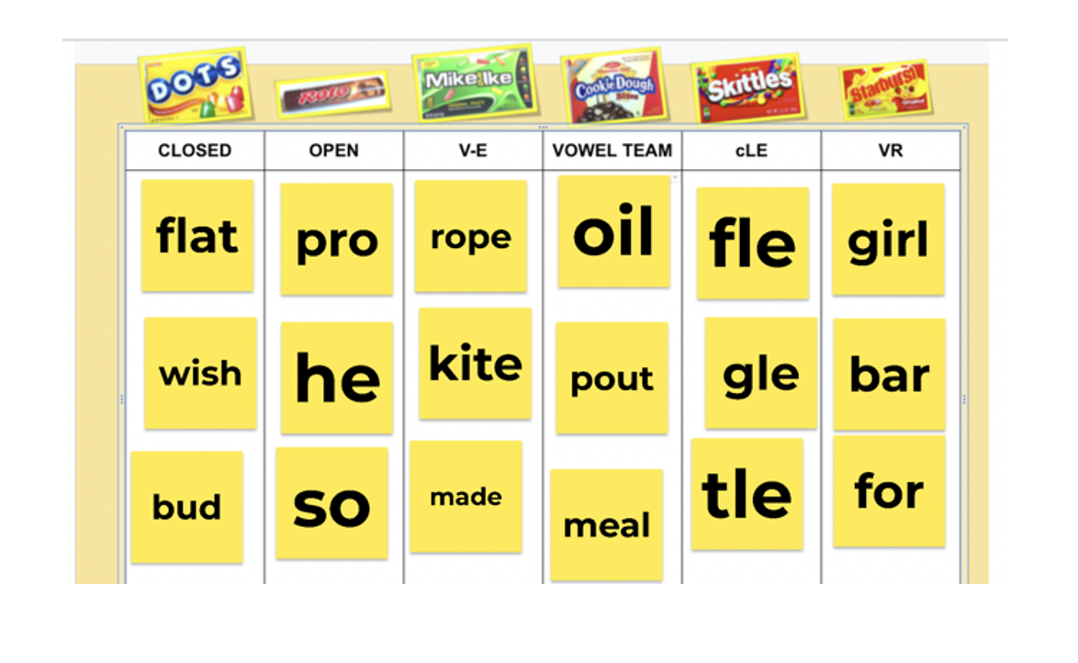
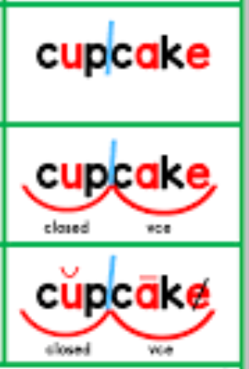
Orthography
Syllables- Knowing the six syllable types helps readers associate vowel spellings with vowel sounds.
Syllable division rules help readers divide and decode unfamiliar words

Slide 8
Morphology
Notes:
Ask what does expository mean. Always bring up vocabulary, even in the directions. Continue to ask even if it’s been taught all year. Dyslexic students need repetition!

Slide 9
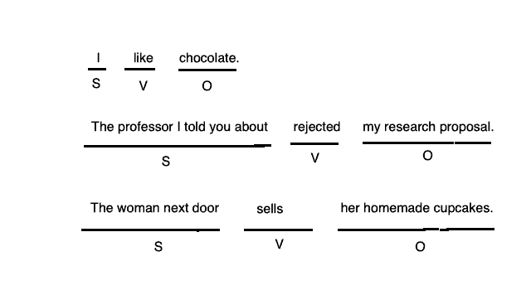
Syntax
Notes:
Ask what does expository mean. Always bring up vocabulary, even in the directions. Continue to ask even if it’s been taught all year. Dyslexic students need repetition!

Slide 10
Semantics
Semantics is concerned with meaning. The Structured Literacy curriculum (from the start) includes instruction in the comprehension and appreciation of written language. .

Slide 11
Structured Literacy Lesson Plan:
Introduction (Hook) Vocabulary (1- 2 words – semantic web) Reading the story (read to, choral, silent) Summary (Card Pyramid) Questions (6 way – main idea, drawing conclusions, finding supporting details, clarifying details, and defining vocabulary in context)

Slide 12
Structured Literacy lesson example:
“The Coffee Bean”
Passage taken from “Six-Way Paragraphs” by Walter Pauk

Slide 13
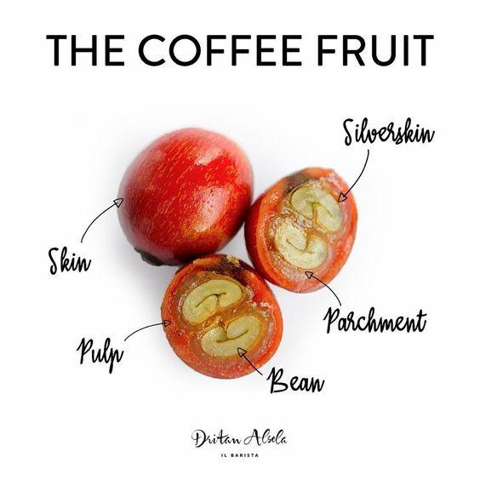
Hook: Grab the student’s attention!
Notes:
A Hook should be short but interesting to your group/ grade level. It is something t For example, with older students, show the Ted Ed video about how coffee is made. Younger students may need a visual of a real coffee plant and the roasted beans, so they can see the difference.

Slide 14
Purpose
As you read today’s expository passage, be ready to discuss how coffee is made.
*It is important to give students something to think about before reading a text. Make it simple and related to the main idea.
Notes:
Ask what does expository mean. Always bring up vocabulary, even in the directions. Continue to ask even if it’s been taught all year. Dyslexic students need repetition!

Slide 15
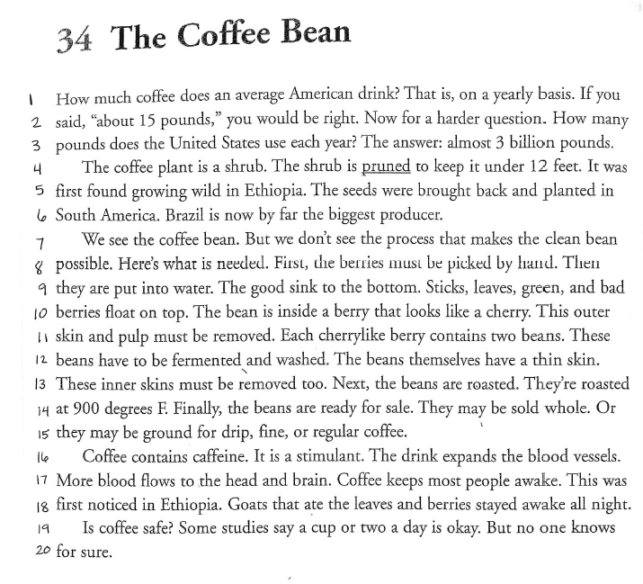
Number the lines in the passage to make it easier to locate words and text-evidence.
Pattern Words: feet, seeds, keeps, bean, clean, leaves
Irregular Words: you, many, they, does, water, head
Find phoneme pattern chosen by teacher, highlight those words in one color. Locate words from Rapid Word Chart and highlight those in a different color.
Pauk, W. (2002). The Coffee Bean. In Six-way paragraphs: 100 passages for developing the six essential categories of comprehension (Third, pp. 68–68). essay, Jamestown.
Notes:
You can play little games with students, Like everyone who is younger than 7 reads the pattern (yellow) words, everyone 7 and older reads the Irregular.

Slide 16
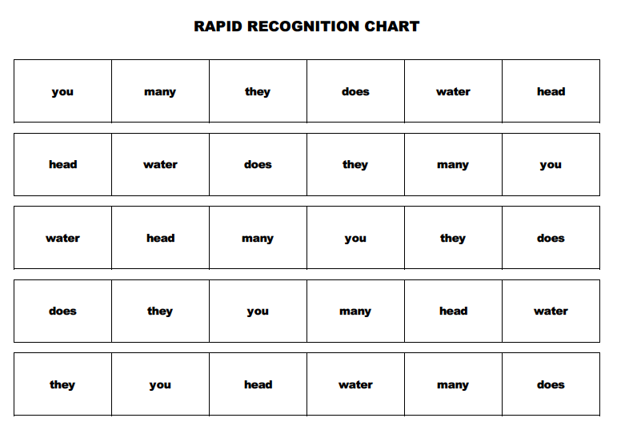
Rapid Word Recognition Chart
Students read the words on the chart for one minute.
Students with dyslexia need 5 times more repetitions for information to be added to their long-term memory.
These words are irregular, they do not follow a phonetic pattern.
Notes:
You can use a rapid word chart for letters, numbers, or anything that you are trying to build automaticity with. These are not necessary for teaching phonetic pattern words as we want our students to decode words that follow the patterns.

Slide 17
The teacher will ask the questions and guide students in writing answers. Use the “think out loud” strategy to help students see metacognition in action.
Students will fill in these last two columns after they have read the passage.
Notes:
Metacognition is thinking about your own thinking. It is a skill that can be taught and modeled in the classroom. For example, “Here’s what comes to mind when I think of people drinking coffee…”

Slide 18
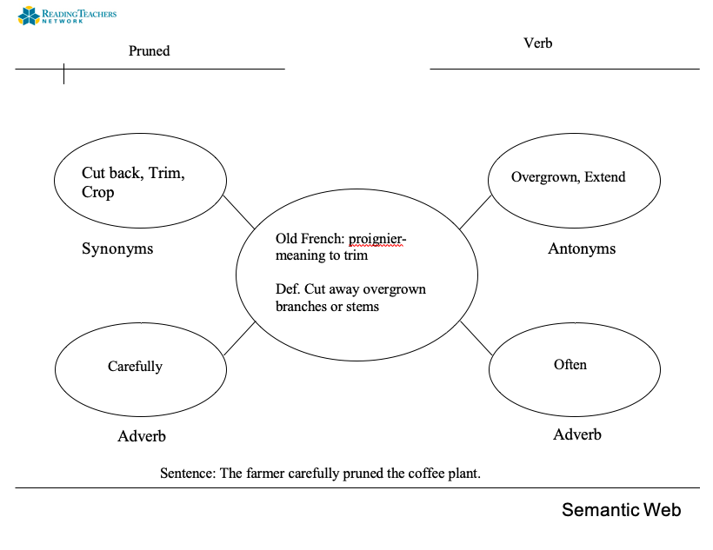
Teacher will choose the word and have the part of speech, Origin, and Def. already filled in.
Notes:
Syntax and Vocabulary

Slide 19
Restate the purpose then students read the passage.
Depending on grade level and text complexity, the teacher will read aloud.
Pauk, W. (2002). The Coffee Bean. In Six-way paragraphs: 100 passages for developing the six essential categories of comprehension (Third, pp. 68–68). essay, Jamestown.

Slide 20
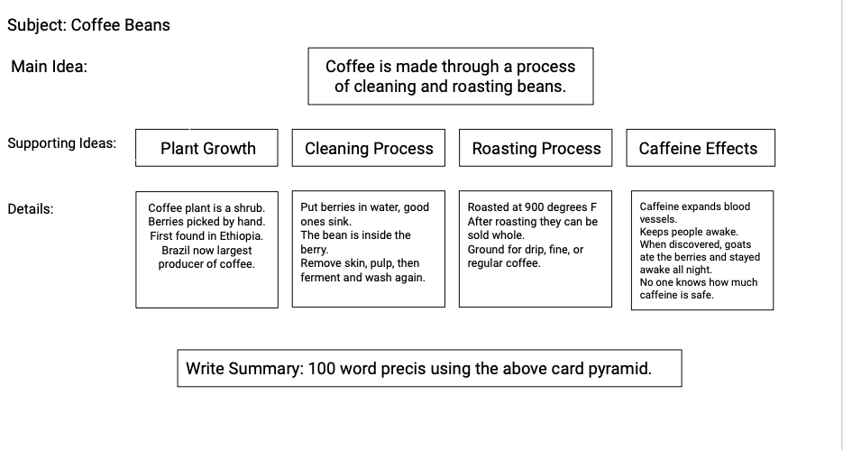
Card Pyramid
Notes:
Ask questions, discuss passage details that may be on an assessment.

Slide 21
Students will reread passage three times, each time with a separate focus.
1st read: focus on punctuation. Have individual students read a portion aloud or with a partner.
2nd read: read the passage for intonation. Use pencil swings.
3rd read: Read as if speaking to a friend.
Pauk, W. (2002). The Coffee Bean. In Six-way paragraphs: 100 passages for developing the six essential categories of comprehension (Third, pp. 68–68). essay, Jamestown.
Notes:
Read the passage

Slide 22
Extensions
Watch “The life Cycle of a Cup of Coffee” on Ted Ed
https://youtu.be/M0VWroX0gZA
Research the effects of caffeine on the human body

Slide 24
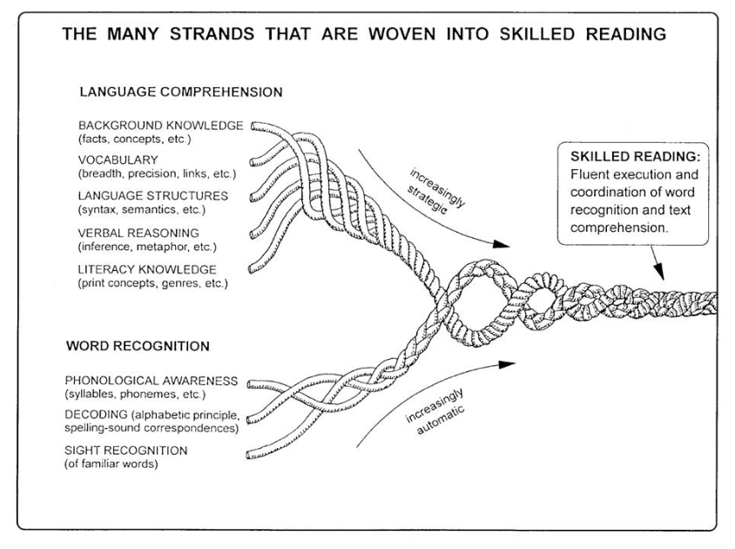
Scarborough, H. S. (2001)

Slide 25
Digital Resources
Reading Rockets Article, Research and Lesson Plan :
Metacognition Strategies
Neuhaus Resources:
Rapid recognition Chart Generator

