Slide 1
The Writing Café
Shakita Jackson & Alissa Hobart
MDE Literacy Coaches
Date: December 1, 2021
Notes:
Shakita
*Materials Needed: number cards for activity, 2 sets printed agree, disagree, neutral, 12 anchor charts around the room, 12+ markers for anchor charts, completed house organizer example anchor chart

Slide 2
State Board of Education STRATEGIC PLAN GOALS

Slide 3
Mississippi Department of Education

Slide 4
Session Norms
Silence your cell phones.
Please check and/or reply to emails during the scheduled breaks.
Be an active participant.
Do not hesitate to ask questions.

Slide 5
Session Goals
Appetizer | Main Dish | Dessert
Discuss the importance of writing. | Examine strategies that build students' comprehension through writing. | Explore strategies to increase students' writing to text to demonstrate knowledge.

Slide 6
Ice Breaker - 3 Corners
I feel comfortable teaching writing.
I teach writing in multiple subject areas.
I utilize a variety of strategies when teaching writing.
My students are excited to write.
Notes:
Alissa
Participants will move to a corner based off of the statement: Agree, Disagree, & Neutral

Slide 7
Importance of Writing
Appetizer

Slide 8
Importance of Writing
Writing:
promotes comprehension;
promotes student participation;
integrates disciplines;
develops good writers;
can be used in every subject;
promotes effective communication within each discipline.

Slide 9
Research
Reading and writing are both functional activities that can be combined to accomplish specific goals, such as learning new ideas presented in a text.
(Fitzgerald and Shanahan, 2000).

Slide 10
Importance of Writing
Writing strategies used to enhance learning in all content areas can be categorized into two categories:
Writing to Build Comprehension
Writing to Demonstrate Knowledge

Slide 11
Writing to Build Comprehension
Main Dish

Slide 12
Writing to Build Comprehension
Writing to build comprehension:
is informal and short;
is used during a lesson to engage students and to develop concepts;
encourages critical thinking;
focuses on ideas instead of mechanics.

Slide 13
Introducing New Strategies
Describe the purpose of the writing strategy
Model the writing strategy and check students' understanding of the new strategy
Monitor and support students during independent writing
Notes:
With any new strategy teachers should introduce the strategy by stating the purpose of the strategy and provide guidelines for the strategy.
Teachers should model the strategy and check the students’ understanding of how to use the strategy.
Teachers should monitor and guide students as they work using the strategy. The more students use a strategy the more proficient they will become using the strategy.
A strategy is only effective if it is taught, modeled, and practiced several times.
The strategies we go over today are primarily designed for second grade and above to be used independently after extensive modeling of the strategy. They will need to be exclusively teacher led for grade K-1.
Graphic organizers are scaffolds, so remember you cannot use one strategy for every mode of writing and some students may not even need the graphic organizer.
Resource:
www.readwritethink.org

Slide 14
RAFT: Role/Audience/Format/Topic
RAFT is a writing strategy that can be used in all content areas and
offers students a choice in their writing assignment;
employs writing activities to enhance understanding of informational text;
encourages creative thinking;
motivates students to reflect in unusual ways about concepts they have read.
Notes:
Shakita

Slide 15
RAFT: Role/Audience/Format/Topic
The RAFT strategy forces students to process information, rather than merely write out answers to questions.
RAFT allows for differentiated instruction.
Students get choice in their assignment based on their interest.
Notes:
With the RAFT approach, students are more motivated to undertake the writing assignment because it addresses various learning styles. RAFT can be used to begin or conclude a unit. At the beginning of a unit, a RAFT writing assignment can assess the students’ background knowledge. At the end of a unit, it can be used to summarize the main ideas and concepts.
The strategy guides students to think from the perspective of others since they are written from the viewpoint of a selected person. They also guide students to consider how to tailor writing for different audiences, and to vary formats according to the purpose for the writing.

Slide 16
RAFT: Role/Audience/Format/Topic
Role of the writer
Who or what are you?
Audience
Who are you addressing?
Format
What form will the writing take?
letter, diary, brochure, memo, speech, or advertisement
Topic (and strong verb)
What will you write about? Why?
Notes:
RAFT is an acronym for a structured technique used to guide student writing.
RAFT assignments are used to demonstrate a student’s knowledge using a defined point of view.
This strategy requires students to write using an assigned format to an audience other than the teacher.
Students must use analysis, synthesis, generalization, and evaluation of information and the points of view of others to credibly write using the assigned format.

Slide 17
RAFT EXAMPLE: Social Studies
Role | Audience | Format | Topic
21st Century Woman | Susan B. Anthony | Thank-you note | Women's Rights
Mohandas Gandhi | Martin Luther King Jr. | Letter | Nonviolent opposition/ resistance
Great Wall of China | Self | Diary | Invaders I have seen and stopped

Slide 18
RAFT EXAMPLE: Math
Role | Audience | Format | Topic
Acute Triangle | Obtuse Triangle | Dear John Letter | Our Differences
Percent | Student | How-To Guide | Mental ways to calculate percent
Plus Sign | Multiplication Sign | Romantic Card | Why We Go Together

Slide 19
RAFT EXAMPLE: Science
Role | Audience | Format | Topic
Lungs | Brain | Persuasive Speech | Why Quit Smoking
Safety Goggles | Family | Letter | Safety in the Lab
White Blood Cell | Red Blood Cell | Romantic Letter | I Will Keep You Safe

Slide 20
RAFT EXAMPLE: Language Arts
Role | Audience | Format | Topic
Comma | Sentences | Thank You Note | Glad I Could Be of Service
Juliet | Self | Diary | My Short Romance
Huck Finn | Jim | Letter | What I Learned on the Trip

Slide 21
RAFT Activity
Work in your groups to select a RAFT from the choice board and write a paragraph. You may also create your own RAFT.
You will have 6 minutes.
Choose a speaker to share the writing.
Notes:
6 min: For this activity, you will need the number card you were handed when you walked in. We have 12 anchor charts that are around the room. Please go to your numbered anchor chart and work with your group to complete your chosen RAFT and write your paragraph.
*Materials Needed: 12 anchor charts, 12+ markers for anchor charts

Slide 22
RAFT Choice Board
Role | Audience | Format | Topic
Comma | Sentences | Thank You Note | Glad I Could Be of Service
Lungs | Brain | Persuasive Speech | Why Quit Smoking
Plus Sign | Multiplication Sign | Romantic Card | Why We Go Together
Notes:
Display for participants.

Slide 23
GIST: Generating Interactions Between Schemata and Text
GIST is a step-by-step process for summarizing text material.
It is particularly valuable with students who have difficulty putting what they have read into their own words.
Students restate main ideas from the text, omitting specific examples and/or evidence used to support or illustrate the concept(s) (Cunningham, 1982).
Notes:
Alissa
GIST is a strategy designed to help students learn to write organized and concise summaries.
Summaries restate only the author’s main ideas, omitting all examples and evidence used in supporting and illustrating points.
For students who are at a loss as how to put a reading into their own words, GIST can be used as a step by step method.
Note: Schemata is the plural form of schema!

Slide 24
GIST
Improves student comprehension of text.
Helps students process new information and make connections with their own ideas/experiences.
Provides a structure for identifying and remembering key ideas.
Helps students surface questions about what they have read.
Notes:
When students summarize paragraphs of text in “their own words” they are a step closer to making the information their own.
Bloom identified summarizing as a method to increase comprehension.

Slide 25
How to Implement: K-1
Read aloud a story to students and model the following steps.
Read the story and orally discuss the important ideas.
Use the graphic organizer and answer the questions.
Who?
Did what?
Discuss where/when or why/how of the story.
Where/when?
Why/how?
Notes:
Teacher models the four steps and then scaffolds practice as needed until students are able to use them independently.
Every passage doesn't lend itself to every question.
Who (character)
Did What (verb)
Then add on where and when.
Sentence will start with when.

Slide 26
K-1 GIST Template
Notes:
Teacher models the four steps and then scaffolds practice as needed until students are able to use them independently.
Every passage doesn't lend itself to every question.
Who (character)
Did What (verb)
Then add on where/when.
Sentence will start with when.

Slide 27
K-1 GIST Example
Title: Chrysanthemum by Kevin Henkes
Read the Story.
Answer the questions:
Who: Chrysanthemum
Did What: was sad about her name.
Write your sentence: Chrysanthemum was sad about her name.
Extension: One day at school, Chrysanthemum was sad because she was made fun of for her name.
Notes:
Teacher models the four steps and then scaffolds practice as needed until students are able to use them independently.
Every passage doesn't lend itself to every question.
Who (character)
Did What (verb)
Then add on where and when.
Sentence will start with when.
If students can answer the "who" and "did" questions, they can write one complete sentence which is a great start for Kindergarten! First graders can begin with one sentence, and you can easily extend their sentences with the inclusion of "where, "when," and "how" to create more complex sentences.

Slide 28
How to Implement: 2-8
Assign a passage to students and model the following steps.
Read the text (or a portion of for longer pieces) and write down the important ideas.
Using the important ideas, write a summary of no more than 20 words.
Continue portion by portion for longer pieces until assigned text is completed.
Write a short summary of the text selection in your own words.
Notes:
Teacher models the four steps and then scaffolds practice as needed until students are able to use them independently. The GIST should be scaffolded based on your students. Some students may write a 20 word GIST while other students may only write 8 to 10 words. This should be done based on your students' needs and the text length.

Slide 29
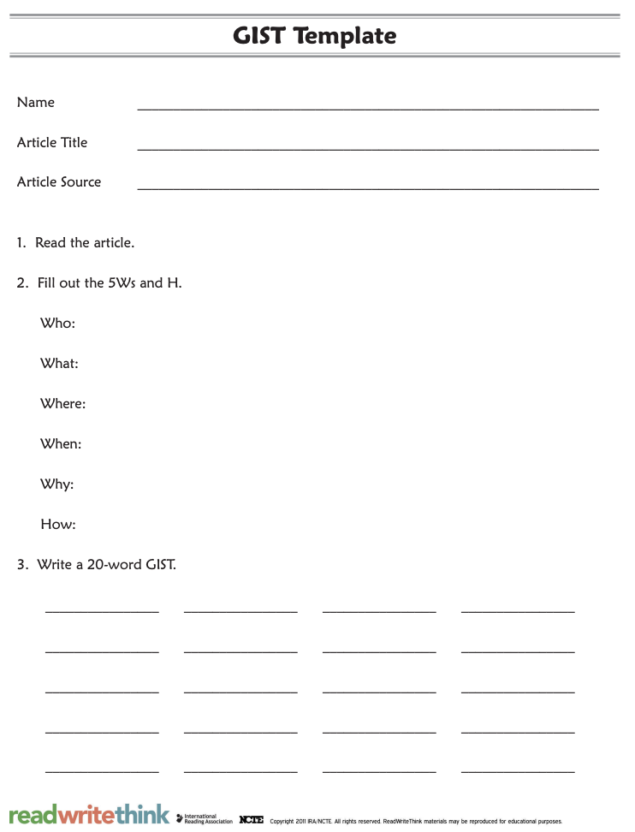
GIST Template
Notes:
Teacher models the four steps and then scaffolds practice as needed until students are able to use them independently.

Slide 30
Writing to Demonstrate Knowledge
Dessert
Notes:
Shakita

Slide 31
Writing to Demonstrate Knowledge
Writing to demonstrate knowledge:
is used to apply students’ knowledge of the text;
responds to a text dependent writing prompt through a specific mode of writing;
uses specific graphic organizers to structure and assist students with organizing their ideas and writing;
has a focus on structure and mechanics.

Slide 32
Four-Square Writing
Four-square writing is a method for teaching basic writing skills that is applicable across grade levels (K-12) and curriculum areas. The four-square organizer can be used to organize information for narrative, expository, and opinion forms of writing.
Notes:
Four square is a scaffolding tool

Slide 33
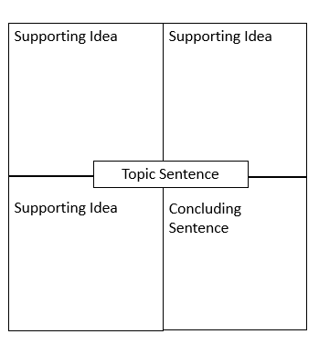
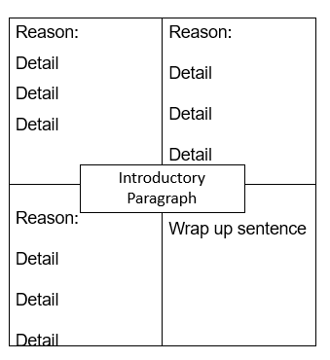
Paragraph to Essays

Slide 34
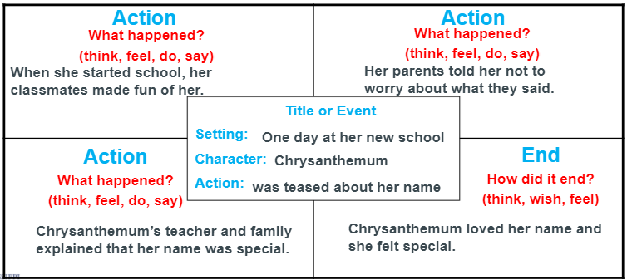
Four Square Example (1st/2nd)
Narrative Prompt: Retell Chrysanthemum, including key details explaining Chrysanthemum’s reaction to her name at the end of the story.

Slide 35
Four Square: Taking it off the Squares
One day at her new school, Chrysanthemum was teased about her new name. When she started school, her classmates made fun of her. Her parents told her not to worry about what they said. Chrysanthemum's teacher and family explained that her name was special. Chrysanthemum loved her name, and she felt special!

Slide 36
The House Organizer
Compare and contrast texts
Determine details and examples that connect texts or support common theme
Organizer helps support structured response
Compare and contrast text themes, ideas, characters, perspectives, etc
Notes:
Alissa-https://writingisthinkingdotorg.files.wordpress.com/2015/02/wacelami.pdf

Slide 37
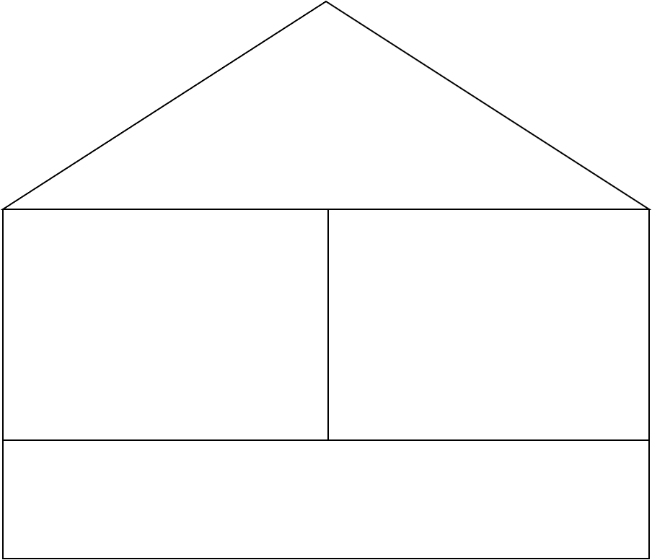
The House Organizer Example
Notes:
We will compare and contrast two common stories to support a common lesson/moral.
The Empty Pot: a Chinese folktale about a little boy named Ping. The emperor wants to find his next successor to the throne, so he gives each child a precious flower seed. The child who grows the best flower in a year will succeed him to the throne. Ping plants his seed in the richest soil and takes care of it, but he only has an empty pot when the time comes. Ping is ashamed of his empty pot, but the emperor smiles when he sees the empty pot. The seeds had been cooked, so that means Ping's was the only child telling the truth. Ping becomes the emperor because he told the truth!
The Boy Who Cried Wolf: A shepherd boy looks after his master's sheep. The job was dull and he had nothing to do during the day. His master had warned him to cry for help if a wolf ever showed up and attacked the sheep so the villagers would come and chase the wolf away. The shepherd boy cried wolf to trick the villagers and they came running, but the realized there was no wolf. A few days later, the shepherd boy cried wolf again, and again, the villagers came running only to find out they had been tricked again. One evening, there was actually a wolf that attacked the sheep, but when the shepherd boy cried wolf, the villagers did not come because they assumed he was trying to trick them again.

Slide 38
The House Organizer Example
Ping is more honest than the shepherd boy.
"The Empty Pot"
- Ping tries to grow a flower
- he is ashamed when he sees the other beautiful flowers
- rewarded for being honest
"The Boy Who Cried Wolf"
- the shepherd boy cries wolf two times and tricks villagers
- villagers did not come because he had lied
- both about telling the truth
- shepherd boy did not tell the truth, so no one believed him
- Ping was honest and was rewarded
Notes:
- important to explicitly model this strategy with students
- great culminating strategy for thematic units or reading texts with common themes
- Could also assign groups of students different text pairs to see the many ways texts may be connected
- Excellent strategy for comparing characters
*Have completed anchor chart showing finished product to go from organizer to writing.

Slide 39
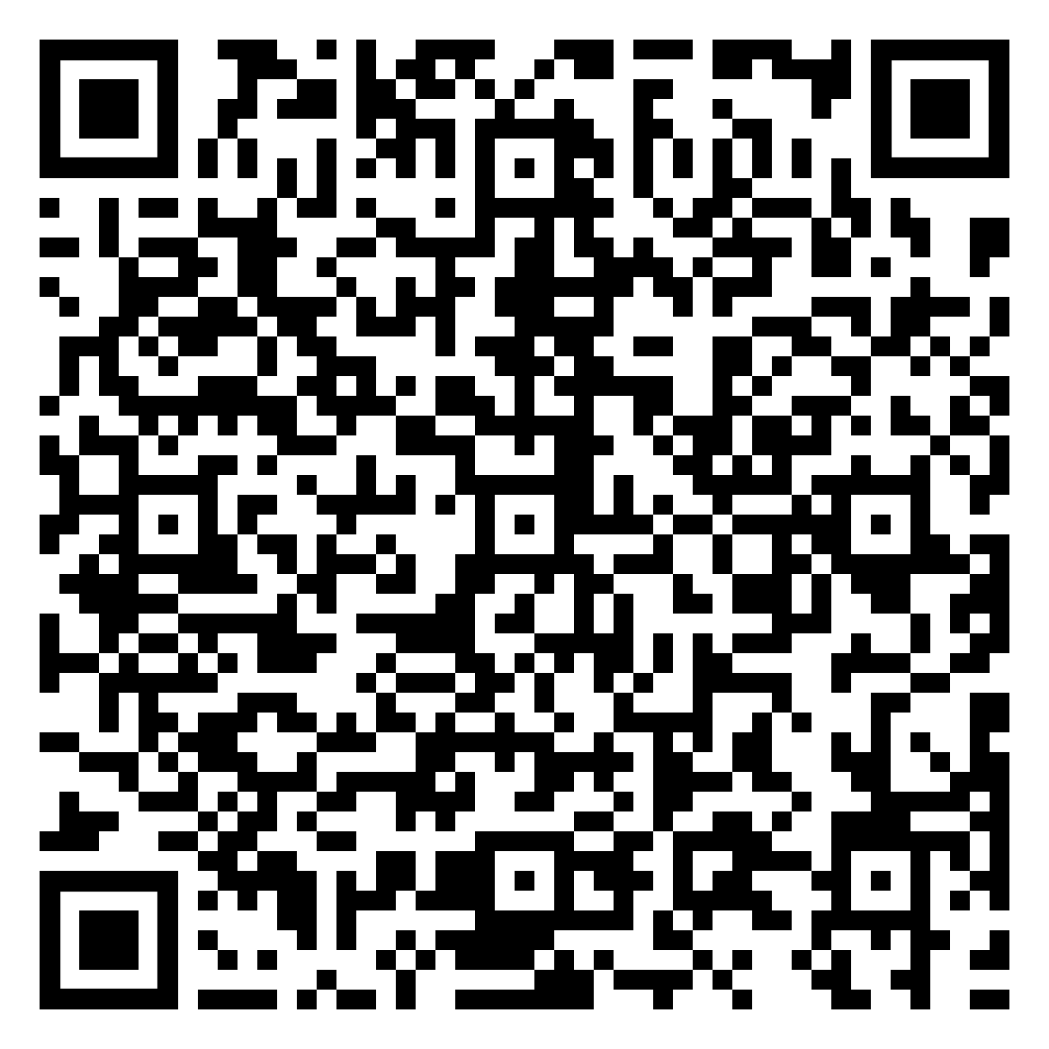
Additional Strategies for Writing
MDE Text Dependent Writing Strategies Guide
https://www.mdek12.org/sites/default/files/Offices/MDE/OAE/OEER/Literacy/Writing/3.22.21_types_of_writing_formatted2.pdf

Slide 40
Stop, Think, Share
Notes:
Share a strategy you would like to implement in your classroom.

Slide 41
Key Takeaways
Writing promotes learning and develops good writers.
Writing strategies can be used to build comprehension.
Writing can be used to demonstrate knowledge of text.
**Graphic organizers should be used as a scaffold to support student writing.**
Notes:
Once students feel comfortable, they may no longer need the graphic organizer.

Slide 42
Questions

Slide 43
Alissa Hobart
Shakita Jackson
MDE Literacy Coach
shakita.jackson@mdek12.org
MDE Literacy Coach
ahobart@mdek12.org

