Slide 1
Building K - 6 Comprehension & Interests Through Science & Social Studies
Presented by M. Gregg & S. Horn
mary.gregg@biloxischools.net
sarah.horn@biloxischools.net

Slide 2
Let’s get to know you....
Who are our K-3 teachers?
Who is self-contained?
Who team teaches?
Anyone departmentalized at this level?
Who are our 4-8 grade teachers?
Who is self-contained?
Who team teaches? Which subjects are paired together?
Who is completely departmentalized?
Are there any high school teachers?

Slide 3
What are some expected hurdles to overcome when trying to convince reading teachers to include Science and/or Social Studies content in their lessons?
Don’t have enough time
Don’t have material or curriculum
Administration is not supportive
Topics are too boring or too challenging
Not tested every year

Slide 4
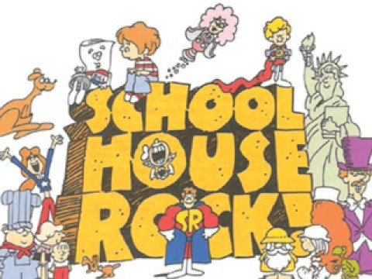
Why should I teach through Integrated Units?
Scienta potentia est...Knowledge is Power!
Once kids are fluent decoders, much of the difference among readers is not due to whether they’re a ‘good reader’ or ‘bad reader’. Much of the difference among readers is due to how wide a range of knowledge they have. If you hand me a reading test and the text is on a subject I happen to know a bit about, I’ll do better than if it happens to be on a subject I know nothing about.
Daniel Willingham, “School Time, Knowledge, and Reading Comprehension” blog

Slide 5
Why should I teach through Integrated Units?
Numerous recent studies found an increase in Reading scores when students dove into Social Studies passages and teachers kept Science in the curriculum.
The background knowledge gained from Social Studies and Science provides the content to understand new and complex text for greater comprehension.
A well documented reason to keep regularly scheduled Science and Social Studies lessons is that students love the activities these topics provide. They provide a natural fit for collaboration and project based learning that allows students opportunities to apply what they learn to their lives. Learning while having fun is impactful in many ways!
https://hechingerreport.org/slightly-higher-reading-scores-when-students-delve-into-social-studies-study-finds/
https://cliweb.org/keep-science-and-social-studies/
https://www.edweek.org/teaching-learning/does-social-studies-build-stronger-readers-a-new-study-suggests-so/2020/09
https://www.forbes.com/sites/nataliewexler/2020/01/13/teachers-think-kids-need-science-and-social-studies-but-still-focus-on-reading-and-math/?sh=7cf36766318f

Slide 6
Why Should I teach through Integrated Units?
“If we look at how skills are acquired outside of the classroom, the process is very distinct. If I want to teach someone how to bake beautiful wedding cakes, we don’t start by measuring flour accurately over and over again, first one cup, then half a cup, then a one-third a cup, then beating one egg, then separating eggs. Instead, we bake cakes. What if I wanted to teach you to repair cars? Yes, you have to read the manual, but will you practice unscrewing bolts over here, and now tightening them properly, and then once you master that, you can remove alternators? No.
If we are preparing students to use reading and writing as tools for communicating ideas for jobs in science, government, teaching, and engineering, why aren’t we teaching them how to think in those fields with reading and writing as the tools they hone as they learn? When science and social studies are a full-fledged part of the curriculum instead of squeezed into incredibly tight schedules, we can integrate literacy tools, introducing and reinforcing reading skills while the student explores and prepares for authentic experiences. This framework could give us more time to explore fundamental topics fully without sacrificing literacy learning.” - Heidi Cruz
https://www.hmhco.com/blog/should-we-rethink-literacys-role-in-how-we-teach-science-and-social-studies

Slide 7
Reading cannot be reduced to a set of “transferable” skills that can be practiced and measured through “cold passages” by a multiple choice assessment designed more to assess test-taking abilities than reading abilities.
Reading is an abiding “power” that builds knowledge, shapes and develops minds FOR A LIFETIME!

Slide 8
How do I teach through integrated units?
Don’t think of ELA, Science and Social Studies as separate and connected disciplines.
“Teaching content IS teaching reading.” Daniel Willingham

Slide 9
How do I teach through integrated units?
2. Use a well-developed curriculum that is rooted in content-rich, high quality instructional material and is built around thematic units of study.
https://msinstructionalmaterials.org/
https://www.coreknowledge.org/
CKLA content and skills outline K-8
First edition material is free to download. Revised edition is sold through Amplify.

Slide 10
How do I teach through integrated units?
3. Tweak, rearrange and/or supplement your existing curriculum. DON’T PANIC! It can be done! Let us tell you how we’ve done it. In this case, less IS more!
Remember...all reading lessons must include the 5 core components backed by the Science of Reading research. MSCCR standards can be addressed in any order during reading lessons through DOK questions. Teach content. Practice skills to aid comprehension.
IF YOU BUILD IT, SKILLS WILL COME!
4. If you are a reading teacher, but your Social Studies and Science are taught by other teachers, we URGE you to work together to coordinate your units so that what students are learning in Social Studies and Science is being reinforced by reading passages and writing prompts in the ELA classroom.
Use the state social studies and science standards to help guide development of units.
REMEMBER...IT TAKES A VILLAGE! TRY TO GET YOUR ART & MUSIC TEACHERS INVOLVED AS WELL!

Slide 11
Where do I find valuable, HQIM resources?
-ReadWorks is a free platform that gives students access to thousands of high interest passages on a variety of topics. Topics can be assigned online & include comprehension & vocabulary questions. A newer addition to this website is the “Article a Day” resources that are specifically aimed at building background knowledge and vocabulary.
-CommonLit is a free digital tool that helps students in grades 5-12 make measurable gains in reading and writing. Teachers can go to CommonLit, create a free account, and access our free library of high-interest, standards-aligned lessons.
-NewsELA is an online news as literacy platform that features high interest articles that features everything from current events to myths and legends from literature.
- Core Knowledge Language Arts® (CKLA) is a comprehensive program (Preschool–Grade 5) for teaching reading, writing, listening, and speaking while also building students’ vocabulary and knowledge across essential domains in literature, world and American history, and the sciences.
-Epic! Is a free online library of books and videos. Many of the books have AR quizzes.

Slide 12
Before Reading:
PREVIEW & PREDICT: While previewing the text, students should make predictions using the headings, pictures and diagrams. Predicting encourages students to think ahead and allows them to understand the text better. Making predictions is proven to improve comprehension.
-
VOCABULARY: Students should build vocabulary squares prior to and during your unit of study. Teaching vocabulary allows students to access academic language and discourse, and facilitates their comprehension of increasingly complex texts.
https://ksevilla.weebly.com/vocabulary-squares.html

Slide 13
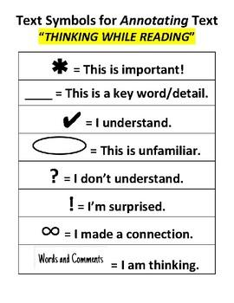
During Reading:
--COLOR CODING: Color coding is an interactive activity that really helps reinforce finding key information in a text. Color Coding can include finding and coloring the main idea and details, using colors to find text structure cue words or just coloring where the answer to a question was found.
https://www.readingandwritinghaven.com/re-reading-with-color-a-reading-strategy-for-older-students/
-ANNOTATING THE TEXT: Annotating a text forces a reader to interact with a text enhancing their understand of, recall of, and reaction to the text.
-MULTIPLE READS OF THE TEXT OR PARTS OF THE TEXT: Close read, choral read, echo read, partner read

Slide 14
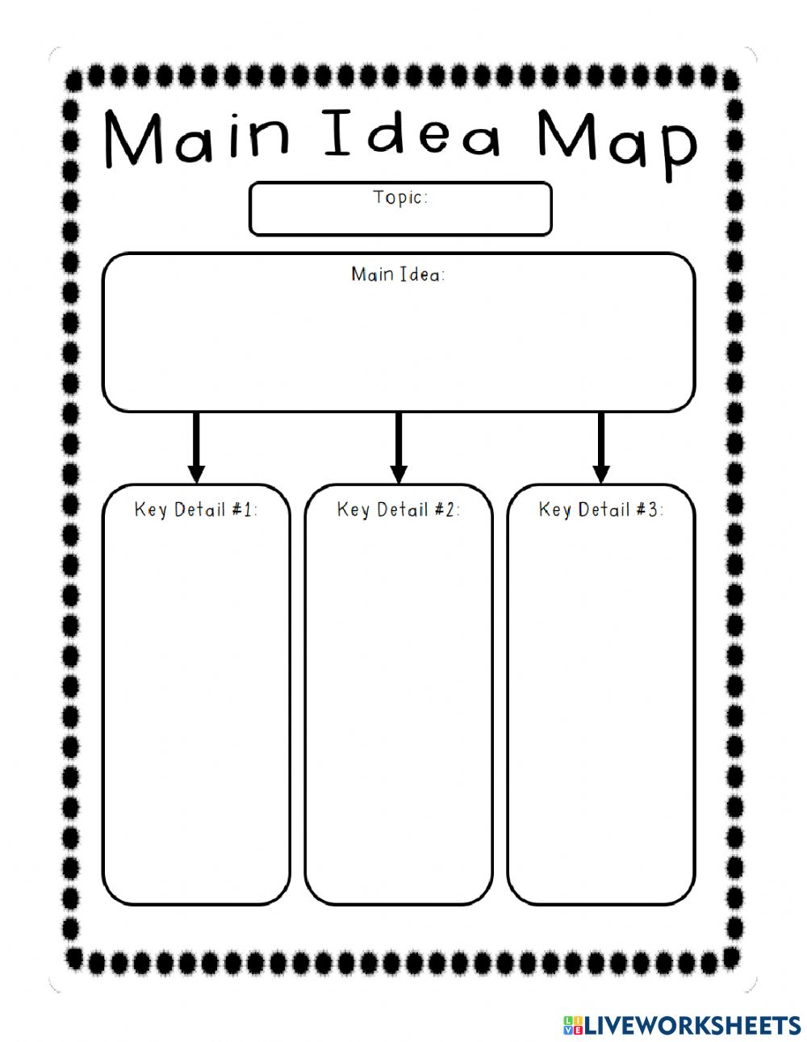
After Multiple Readings:
Summarizing: Have students capture the main points of the text in a brief summary.
Ask a variety of DOK and skill-based questions to ensure comprehension.
Writing: Create writing prompts for students to use to respond to the text.
Use strategies from The Hochman Method (The Writing Revolution resources)

