Slide 1
Literacy Support for Gifted Students
Mat Sheriff
Academic Intervention and Gifted Specialist
December 3, 2021

Slide 2
State Board of Education STRATEGIC PLAN GOALS

Slide 3
Mississippi Department of Education

Slide 4
Goals

Slide 5
Session Goals
Discuss characteristics of gifted learners
Discuss the concept of differentiation for the gifted
Review the unique needs of gifted readers
Provide best practices that include a literature-based approach, writing in response to literature, and moving readers into the “personal art” of reading

Slide 6
Characteristics of Gifted Learners

Slide 7
Characteristics of Gifted Learners
Intellectual | Creative
Curious | Wonders
Complex, abstract ideas | Daydreams/Off-task
Makes connections | Lots of ideas
Intense | Improvises
Guesses well | Intuitive
Sees multiple viewpoints | Questions mastery
Very original | Bizarre ideas/ plays with concepts

Slide 8
Characteristics of Gifted Learners

Slide 9
A Current Understanding of Differentiation for Gifted Students:
From Diane Heacox and Richard Cash

Slide 10
What is differentiation?
Differentiated instruction is a teaching approach that tailors instruction to students’ different learning needs. It lets students show what they know in different ways.

Slide 11
Differentiation
The original intent or the purpose of this strategy, as used in gifted education, was to design curriculum and instructional opportunities that sought to meet the individual needs, abilities, and interests of each gifted student ​
This should result in using enrichment, acceleration, and rigor* in providing individual academic challenge ​
It is important to recognize that differentiation for gifted students is different from general classroom differentiation ​

Slide 12
A note on Rigor
Rigor denotes a greater concern for conceptual thinking rather than memorization as well as quality rather than quantity. It is a variable rather than a standard and increases in response to individual progress. (Kingore: 2013, 2014)​
It involves relevant and realistic learning experiences with real world connections that provide academic challenges which result in in-depth thinking and discovering deeper meaning.​
Not simply more and harder stuff!​

Slide 13
Differentiation for Gifted Students
Differentiation for gifted students does not mean simply giving them more activities to do that the learner may see as more of the same (what we call ”MOTS”). Instead, the content focuses on advanced concepts and complex ideas, and learners use strategies (step-by-step tasks) and thinking skills with greater degrees of sophistication. Indeed, these students should be using the tools of a practicing professional – a disciplinarian – to produce authentic products that have value to a real-world audience. This all takes place in an environment that builds students’ intrinsic motivation to take on more responsibility for their own learning; that is, they become autonomous learners.

Slide 14
Differentiation for Gifted Students
Heacox and Cash base their approach on current brain research​
Gifted students have more neural connectors in their frontal cortex​
Gifted learners process information more quickly ​
Gifted learners can make complex connections between ideas and thoughts
Differentiation for Gifted Learners: Going Beyond the Basics.

Slide 15
Differentiation for Gifted Students
Differentiation provides an optimal strategy for gifted students. It allows them:​
To take advantage of their basic nature and skills
Points them to study issues that are of importance to them
Allows for more authentic learning: Real life problems – real life solutions
Encourages them to move to in-depth thinking to sort, categorize, and generalize into abstract concepts the great number of facts that they have “naturally” acquired
Heacox and Cash

Slide 16
What Might this Look Like?
Students take the role of a professional and research areas of their interests
They learn the skills of that profession or discipline
This gives them the opportunity to view issues through the lens of a professional
They produce real life solutions

Slide 18
Supporting Gifted Readers

Slide 19
Who are Gifted Readers?
They have a passion for reading​
They learn to read earlier often spontaneously in preschool​
They learn to read independently soon after classroom instruction begins​
They read better (advanced reading abilities) and at a faster rate

Slide 20
Who are Gifted Readers?
They read materials beyond the norm for their age​
They have an advanced and large vocabulary
They require less drill – if any – to master techniques of the reading process
They read longer
“…a reading program for gifted and talented readers should emphasize reading to learn rather than learning to read, then program goals should be differentiated from those of beginning or struggling readers.”​
Patricia Wood

Slide 21
Strategies Supporting Gifted Readers
Compacting the regular curriculum
Acceleration of content and/or text
Inquiry reading & independent study opportunities
Use of more advanced trade books
Independent reading and writing choices
Focus on developing higher level comprehension skills, along with higher level questioning
Opportunities for book discussions – critical reading & creative reading
Use of technology and the web
Adapted from “Reading Instruction with Gifted and Talented Readers” by Patricia F. Wood, Gifted Child Today
(Summer 2008) & “Schoolwide Enrichment Model-Reading” <http://www.gifted.uconn.edu/SEMR/>

Slide 22
Book Talk
Gifted readers book talk - Untwine by Edwidge Danticat - YouTube

Slide 23
Three Concepts in Supporting Gifted Readers

Slide 24
Concept One
Use literature to supplement or better yet replace basal texts​
Basal readers are designed to introduce basic vocabulary and basic comprehension
Gifted readers are already into “chapter books”​
They are probably reading high above the level you might be planning to use​
Gifted readers are into “story,” theme, and style

Slide 25
Concept Two
Form discussion groups based on books​
Go beyond plot and fact questions​
Focus on themes and style
Use higher level questioning strategies​
Follow discussion formats from programs such as the Junior Great Books’ Shared Inquiry Method, which focuses on interpretation ​

Slide 26
Concept Three
Provide instruction in the study of literature at an early age:​
Teach the Elements of Literature​
Discuss the different Methods of Analysis​
Use Rosenblatt’s Level of Responses​
Teach the Response Analysis Approach

Slide 28
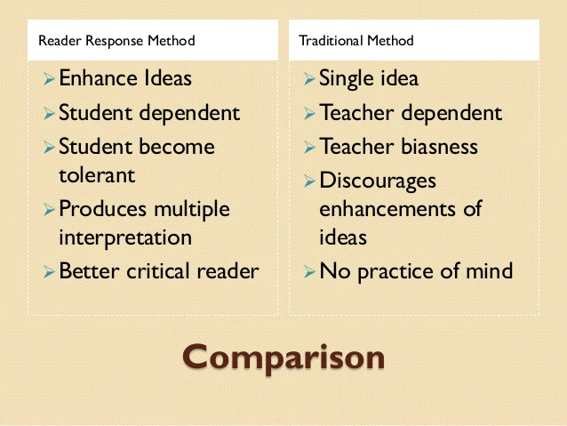

Slide 29
Book Selection

Slide 30
Types of Books for Gifted Learners
Gifted students should read books that are:
• Sophisticated beginning-to-read books
• Nuanced language - varied and complex language structures
• Multidimensional characters
• Visually inventive picture books
• Playful thinking
• Unusual connections; finding patterns and parallels within and among
books
• Abstractions and analogies
• A blend of fantasy and non-fiction
• Extraordinary quantities of information about a favorite topic
• Books about gifted children

Slide 31
Some Teacher Favorites…
Black Beauty
Sarah Plain and Tall
Where the Red Fern Grows
Little House series
The Secret Garden
Narnia Tales
Charlotte’s Web
Harold and the Purple Crayon
Indian in the Cupboard
The Velveteen Rabbit
Dear America series
Grimm’s Fairy Tales
Stuart Little
Anne of Green Gables
Stone Fox
Charlotte’s Web
Fantastic Mr. Fox
Because of Winn Dixie
Love That Dog Tornado
A Wrinkle in Time
Joseph Had a Little Overcoat
Curious George
Peter Pan
Tales of a 4th Grade Nothing
Polar Express
Misty of Chincoteague
Fudge (all)
Green Eggs and Ham
Humphrey
Abel’s Island
Wind in the Willows
Love You Forever
Where the Wild Things Are
Andrew Henry’s Meadow
Little Women

Slide 32
https://youtu.be/Omx_iLtMjZA

Slide 33
Resources and References
reading strategies for gifted students - Gifted and Talented Resources Directory
https://drive.google.com/drive/folders/0B7kiQHkDTiEQR1pJQTZrdFhUYnc
50 Tips, Tricks and Ideas for Teaching Gifted Students - WeAreTeachers
Support Literacy in Gifted Students with These Reading Strategies (uta.edu)
Gifted Readers and Reading Instruction | Hoagies' Gifted (hoagiesgifted.org)
Five Ways to Support Gifted Students in Your Classroom | Kaplan Early Learning Company (kaplanco.com)
Tips & Strategies for Teaching the Gifted Student - BrightHub Education
PLC_Differentiation_for_Gifted_Learners-1.pdf (freespirit.com)

Slide 34
Resources and References
Literacy Today - teacher inspired Secondary ELA resources - Reader Response
Louise Rosenblatt - Literary and Critical Theory - Oxford Bibliographies
8ef164f3f6b95dc94c654c92ccfc7d9c.png (3150×2400) (pinimg.com)
d03b0c15145b8f3d9394f2465bf98c40.jpg (642×494) (pinimg.com)
Parent Connection (ops.org)
Schoolwide Enrichment Model-Reading | Renzulli Center for Creativity, Gifted Education, and Talent Development (uconn.edu)

Slide 35
Resources

Slide 36
Mat Sheriff
Academic Intervention and Gifted Specialist
msheriff@mdek12.org

