Slide 1
Ready Minds, Ready Readers: Promoting Executive Functioning Skills in Young Children to Support Literacy Development
Dr. Sarah L. Swauger, Program Director, Mississippi Early Education Family Partnership
and
Dr. Angela S. Rutherford, Director Center for Excellence in Literacy Instruction, Professor, The University of Mississippi

Slide 2
Agenda
Galinsky’s Seven Essential Life Skills
Life Skills and Their Pivotal Role in Learning to Read
Promoting Executive Function-based Life Skills During the Reading Block
Notes:
ANGELA:
This presentation will follow a structure progressing from the conception of the skill, to the role that skill plays in reading, to practical application in reading classrooms.

Slide 3
Executive Functions
Working Memory
Cognitive Flexibility (flexible thinking)
Inhibitory Control
Notes:
ANGELA:
Why are they called executive functions? Executives have the power to put plans into effect. It is the top dog who does the controlling. Executive functions are the functions that come from the pre-frontal cortex and command /make decisions about what to do.
What do each of these executive functions entail?
Working memory: Retaining information while working with it (reading/ decoding AND understanding the text/ predicting, analyzing simultaneously
Cognitive flexibility: The ability to change gears when needed, to think outside the box/change priorities
Inhibitory control: Take oneself off auto-pilot and do what is appropriate despite impulse.

Slide 4
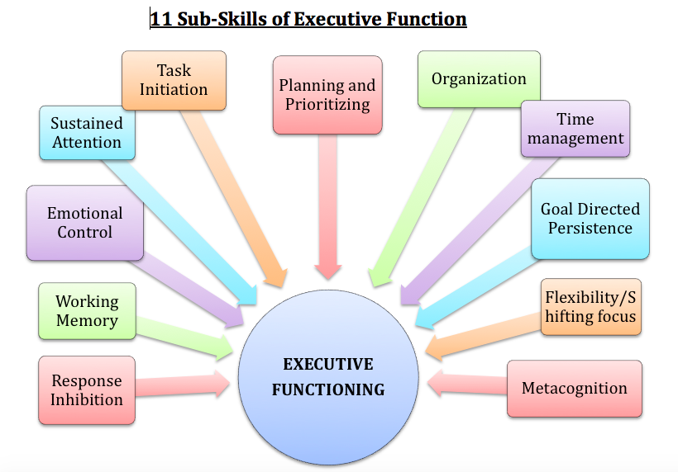
Executive Function Sub-Skills
(Dawson & Guare, 2009)
Notes:
ANGELA: (Quick overview)
Executive functions can be parsed into many sub-skills.
Response Inhibition: The ability to stop a response and think first. For example, filtering what is said before saying it. Considering how it will be taken up or constructed by another.
Many of these subskills have to do with focus and sustained attention: goal directed persistence, planning, prioritizing, time management, initiation. They help us get through the things we don’t necessarily want to do. We make the active choice to do it anyway.

Slide 5
Galinsky’s Seven Essential Life Skills
Focus and Inhibition (self-control)
Perspective Taking
Communication
Making Connections
Problem Solving/Critical Thinking
Taking on Challenges
Self-direction
(Galinsky, 2010)
Notes:
ANGELA:
Explain the connection between executive functions and the seven essential skills. The essential life skills are derived from executive functions and then categorized by similarity. For example, communication involves response inhibition, metacognition emotional control, as well as planning and organization. These seven skills are attention-regulation skills.
Galinsky’s seven essential life skills are based on 18 years of executive function research across disciplines (neuroscience, behavioral)
Each skill builds on the other. It is difficult to effectively communicate if one cannot focus or take another’s perspective
Focus and Inhibition: Helps children pay attention in a way that allows them to learn
Perspective Taking: The ability to consider others thoughts and feelings.
Communication: The ability to express one’s thoughts so they are understood by others. Communication involves using working memory because one has to hold onto what someone else said in order to respond. It also requires inhibitory control because one has to allow others to finish what they are saying before responding and also think about how the communication will be taken up by the receiver.
Making Connections: To find links between ideas and information. It involves creativity. The most creative individuals make the most unique connections.
Problem Solving and Critical Thinking: The ability to analyze information and determine whether it is valid and reasonable as well as develop solutions for problems.
Initiation: Deciding to do something difficult and stick with it.
Self-direction: A child’s ability to seek knowledge and skills on their own—to take control of their learning.

Slide 6
Fluidity of Life Skills
Life skills are not something we master; they require practice and intentionality for children as well as adults. It’s like exercise. We can build the muscles and endurance, but if we stop using them, they begin to disappear (Galinsky, 2010).
Notes:
Anyone can learn these life skills at any age.

Slide 7
What it takes
Reading Skill | EF Requirements
Letter Recognition | Attention, Persistence, Metacognition, Working Memory)
Decoding/Comprehension | Working Memory, Goal Directed Persistence, Metacognition, Attention, Planning and Prioritization
Words with Multiple Meanings | Flexible Thinking, Metacognition
Passive Voice | Metacognition, Working Memory
Focus | Metacognition, Attention, Goal Directed Persistence, Emotional Control
(Kelly, n.d)

Slide 8
Skill 1: Focus and Inhibition (Self-control)
This skill requires the ability to tune out distractions, maintain attention, and be flexible. If it is not practiced early, it can become more difficult as children age (Meltzer & Greschler, 2018).
Think about a time in your life when you exhibited a great deal of focus and self-control. What kept you strong?
Think about times in your life when you have struggled to maintain focus and self-control. What distracted you?
Children need to be taught strategies for inhibition. They need opportunities to practice.
PROMOTE IT:
Simon Says
Stop and think time/songs
Red light/green light
Musical chairs
Say the opposite games
Notes:
From here we will move through each of the life skills and discuss what they are and how they can be promoted in a reading class.
Focus and self-control play an enormous role in a student’s ability to learn. If they aren’t focused, they can’t absorb the information.
(Melzer & Greschler, 2018) Difficulty increases as students age because they have to use more EF to synthesize information they read from texts they are asked to read. They need skills learning to set goals and power through reading they don’t want to do.

Slide 9
Focus/Self-Control and Reading
Decoding text requires a significant amount of cognitive capacity when first learning to read.
“If we think about what students face when they tackle a textbook, we can see EF at work, from planning where and when to read to extracting meaning in a way that supports understanding, retaining and applying information. In short, reading equals hard mental work” (Hecker, 2021).
PROMOTE IT: Explain that it is normal for their brains to become tired when they are building it, but there are ways they can work at making it stronger:
I will read for 5 more minutes and then take a break
I can play with my pop-it while I read
Incorporate quick phonemic awareness and phonics games that provide opportunities to practice self-control:
Simon says say the sound that K makes
Phonics paddle game: Hold the paddle with the letter, and students can only say the sound when you lift the paddle upwards. This gives them wait and think time before calling out a sound.
Meta-cognitive check-in practices:
Do I hear my reader voice?
What was this paragraph about?
What was the author trying to tell me?

Slide 10
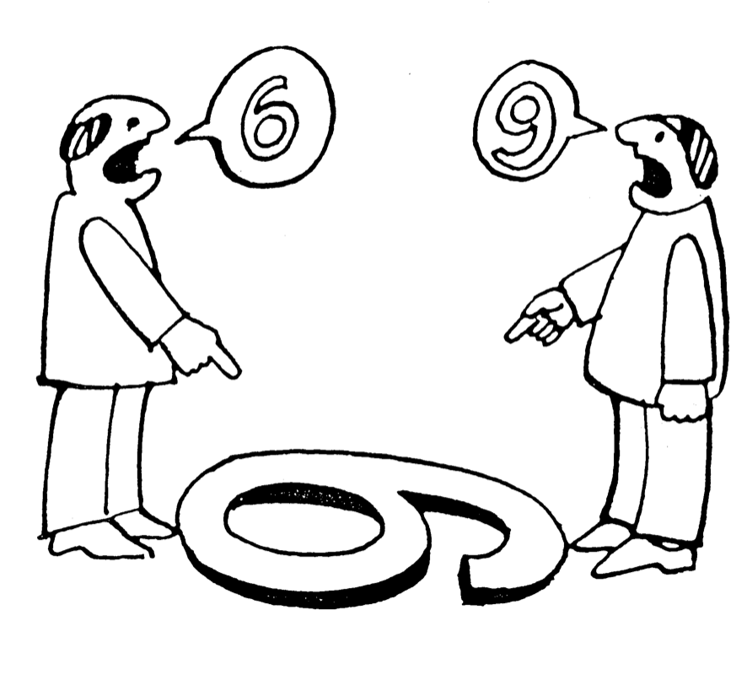
Skill 2: Perspective Taking
Perspective taking is the ability to consider and react accordingly to what another person might be feeling or thinking (and sometimes to predict that behavior)
This can be especially difficult for very young children (it typically begins to develop around age 4) and reading is the perfect way to practice this important skill.
PROMOTE IT:
(Reading AND Videos)
Ask children to explain what a character is feeling and why.
Ask them to predict how a character might react to an event.
(Theses are both skills connected to RL 3)
Notes:
https://www.youtube.com/watch?v=N2MbLStTY2g

Slide 11
Skill 3: Communication
Communication is the ability to convey one’s thoughts and feelings and to consider how it will be understood by others. Children must be able to read the social cues of others and respond accordingly.
PROMOTE IT:
Read books and pay attention to the facial expressions of characters.
Analyze the reactions of characters and evaluate how well they responded in their environment.

Slide 12
What does Danny’s facial expression say about how he feels?
How are the other children feeling? How do you know?
What do you think will happen if Danny keeps trying?
What might the other characters say?
What will happen if he gives up?
What will the other characters say?
How could Danny communicate his feelings right now in a way that will help him?

Slide 13
Skill 4: Making Connections
Those who are viewed as creative are able to make unconventional connections. Making connections is a life skill and it is also a reading strategy. Active readers constantly make connections with their own experiences or what they have read or learned about. It helps with comprehension because making text connections requires focus and thought.
PROMOTE IT:
Text-to-text
Text-to-self
Text-to-world
Deep not shallow
connections
Erik Winkowsky, New York Times

Slide 14
Making Deep Connections
Encourage all children to explain their connection and refer to specific portions of the text (verbally or written). They should give specific and detailed accounts of the connection they are making to their experience or something they have heard or read about.

Slide 15
Skill 5: Problem Solving/Critical Thinking
Critical thinking is the ability to analyze, interpret, infer, explain, and problem solve.
PROMOTE IT: Critical thinking and reading comprehension go hand in hand.
Predictions- children predict many ways a story might end based on choices the characters might make (this requires mental flexibility and creativity).
Believe it?- When reading non-fiction, take time to ask children if they believe what they are reading and why. Why should or shouldn’t they believe the author?
What to do? Solve the problems of characters by determining what they should do next.
Notes:
Refer to slide 9 Communication and point out how the activities require students to analyze and evaluate.

Slide 16
Skill 6: Initiation/Taking on Challenges
Initiation is the ability to begin and stick with a difficult task rather than shying away.
PROMOTE IT:
Read books like the “What Should Danny Do series” that involve opportunities to take on challenges and discuss the benefits of sticking with something that was difficult.
Read non-fiction about real people who faced challenges that children can connect to. Discuss and write about how they overcame those challenges.
Notes:
In slide 10, Danny had an opportunity to continue taking on the challenge and succeed or give up and cope by playing with the slime instead.

Slide 17
Skill 7: Self-direction
Self-direction involves setting goals for oneself and making plans to meet those goals.
PROMOTE IT:
Book choice and projects
Students schedule goals and due dates
Literature Circles (Daniels, 2002)
Multi-genre research project (Putz, 2017)
Free choice centers

Slide 18
It’s easy to incorporate life skills into everyday reading instruction
What are you already doing?

Slide 19
Questions?
Angela S. Rutherford, Ph.D.
Professor, The University of Mississippi
araines@olemiss.edu
Sarah L. Swauger, Ph.D.
Director, Mississippi Early Education Family Partnership
slswauge@olemiss.edu

Slide 20
References
Daniels, H. (2002). Literature circles: voice and choice in book clubs and reading groups. Portland, ME: Stenhouse Publishers.
Dawson, P., & Guare, R. (2009). Smart but scattered: The revolutionary “executive skills” approach to helping kids reach their potential. New York: Guilford Press.
Galinksy, E. (2010). Mind in the making: The seven essential life skills every child needs. New York, NY: Harper Collins.
Harvard University Center on the Developing Child. (n.d). Retrieved from
https://developingchild.harvard.edu/resources/what-is-executive-function-and-how-does-it-relate-to-child-development/
Hecker, L. (n.d). The reading brain: Executive function hard at work. Retrieved from https://ldaamerica.org/info/the-reading-brain-executive-function-hard-at-work/
Kelly, K. (n.d). Five Ways Executive Functioning Issues can Impact Reading. Retrieved from
https://www.understood.org/en/learning-attention-issues/child-learning-disabilities/executive-functioning-issues/5-ways-executive-functioning-issues-can-impact-reading
Meltzer, L., & Greschler, M. (2018). Executive Function Strategies: The Building Blocks for Reading to Learn. International Dyslexia Association, 7,(4). Retrieved from https://dyslexiaida.org/executive-function-strategies-the-building-blocks-for-reading-to-learn/
National Center for Learning Disabilities. (2008). Executive function fact sheet. Retrieved from https://www.readingrockets.org/article/executive-function-fact-sheet
Putz, M, (2017). A teacher’s guide to the multi-genre research project. Portsmouth, NH: Heinemann.

