Slide 1
Teaching for Deeper Learning Using CKLA
Sherry Barnes
Demetras Jones
MDE Literacy Coach
MDE Literacy Coach
December 1, 2021
Notes:
Good afternoon! My name is Sherry Barnes and I am a Literacy Coach for the Mississippi Department of Education Office of Elementary Education and Reading. With me today is Demetras Jones. She is also a Literacy Coach for the Mississippi Department of Education. We are so excited to be with you today and we hope you get a lot of information to take back to your classrooms from this session.

Slide 2
State Board of Education STRATEGIC PLAN GOALS
Notes:
The State Board of Education has created six strategic plan goals. Today, our session will focus on Goal 4: Every school has effective teachers and leaders.

Slide 3
Mississippi Department of Education
Notes:
The vision of MDE is to create a world-class educational system that gives students the knowledge and skills to be successful in college and the workforce, and to flourish as parents and citizens. The mission of MDE is to provide leadership through the development of policy and accountability systems so that all students are prepared to compete in the global community.

Slide 4
Session Goals
Define deeper learning
Identify the 7 Thinking Skills
Explore tools used for deeper learning
Review strategies for deeper learning using content from CKLA
Notes:
We have determined four goals for our session today. 1. Define what deeper learning is, 2. identify a set of seven thinking skills, 3. explore some of the tools identified and described in the book: Teaching for Deeper Learning: Tools to Engage Students in Meaning Making, and 4. review strategies for deeper learning using CKLA as our content source.

Slide 5
Session Norms
Be respectful of presenters and others
Be an active participant
Silence cell phones and devices
Notes:
Our norms for today’s session include: be respectful of presenters and others, be an active participant, and please silence all cell phones and devices.

Slide 6
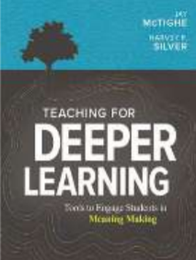
What Is Deeper Learning?
What does it mean to learn something deeply?
Developing conceptual understanding
Learning that enhances the retention of information
Ability to transfer learning to new situations
Notes:
Jude the Obscure, quadratic equations, the Dardanelles: what do these things have in common? They are probably things that you "learned" for a test and even passed, only to forget almost immediately. The information may not have been important or interesting to you, or maybe you only learned it by memorizing. This is inert knowledge—learning that was superficially acquired, never really understood, and then promptly forgotten (National Research Council, 2000). Now contrast those examples with something that you really understand—learning that has endured. (pause) What is the difference in how you came to learn and understand it? What can you now do because of that understanding? This is deeper learning. It can be defined as: read bullets... Isn’t deeper learning what we want for our students? The ability to transfer their learning elsewhere? After reading the book, Teaching for Deeper Learning: Tools to Engage Students in Meaning Making, I really wanted to share some of these tools with the teachers I work with. Across the state literacy coaches have been working on shifting instruction to include meaning making and knowledge building. The tools and strategies presented in this book helps make that visible in our classrooms. We hope that by the end of this session, you will have some tools to take back to share with your students.

Slide 7
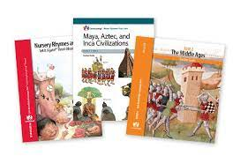
What is CKLA?
CKLA is a language arts curriculum made available from the Core Knowledge Foundation
The program offers free downloadable curriculum for grades pre-k- 6 with a variety of titles and topics that build from one year to the next

Slide 8
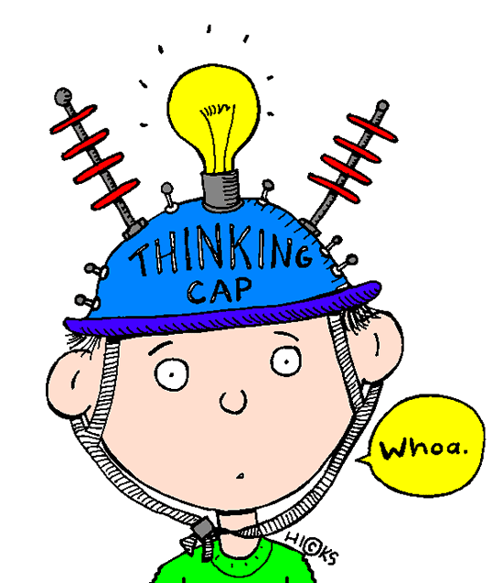
7 Thinking Skills
Conceptualizing
Note making and summarizing
Comparing
Reading for understanding
Predicting and hypothesizing
Visualizing and graphic presentation
Perspective taking and empathizing
Notes:
These are the 7 Thinking Skills. We will give a brief overview of each skill during the presentation today.

Slide 9
Thinking Skill #1: Conceptualizing
There are two main reasons for organizing instruction around core concepts and helping students construct meaning for themselves.
It stimulates active meaning-making and leads to deep learning. Students retain more of what they learn in class.
Teachers cannot always be there to identify what is important.
Notes:
Example: Are students going to remember the time they learned about the planets in the our solar system or that time they learned to recognize the main idea in a multi-paragraph reading passage?

Slide 10
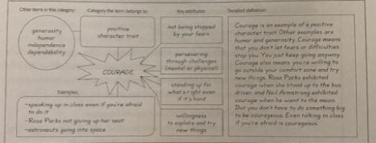
Conceptualizing- Make It Visual
citizenship
yes | no | yes | no
voting | bullying | helping others | littering
Concept Attainment
Concept Definition Map

Slide 11
Thinking Skill # 2: Note-Making and Summarizing
Summarizing and note-making are critical essential learning skills.
Both require active processing of information that leads to deeper understanding.
These have been proven to have positive effects on student learning.

Slide 12
Tools for Note-Making and Summarizing
Examples of Tools in the Note-Making Process
Window Notes- helps students with true note-making by having them generate questions, personal reactions and interesting connections as well as facts.
4-2-1 Summarize- a collaborative process to help students learn how to identify essential information, construct a main idea, and write a concise summary.
AWESOME Summaries- a technique that helps students summarize.

Slide 13
Window Notes
Immigration:
Facts Immigrants are people that leave their home country to settle in a new country. Push factors are the problems in one’s home country that would “push” you out, or make you leave. | Feelings & Reactions I feel sad that people were afraid in their home country. I feel angry that people do not have freedom like we do.
Questions Why didn't people have freedom in their home country? Was their life better when they came to the New World? | Connections I saw something on TV about people coming to the U.S. because of war in their home country. I read in a magazine where people were coming here illegally.

Slide 14
4-2-1 Summarize
This note-making strategy uses both individual and collaborative methods.
Reasons people left one country and came to another are called push and pull factors. | Push factors are what makes you leave your home country. | People left for money troubles. | People left for religious freedom.
Four key ideas
Reasons people left one country and came to another are called push and pull factors. | Push factors are what makes you leave your home country.
The two most important ideas
Reasons people left one country and came to another are called push and pull factors.
Push and Pull Factors
The one most important idea
Notes:
First, students record four big ideas from the text on an organizer. Each student then pairs up with another student to share and compare ideas and decide on the two most important ideas. Pairs of students then form a group of four. These four students share and compare to decide the single most important idea.

Slide 15
AWESOME Summaries
A: Is the information in my summary accurate?
W: Has the length of the original material been whittled down significantly?
E: Did I include enough information to capture the essence of the original material?
S: Is the information in my summary logically organized and sequenced?
O: Did I give an objective (free from personal opinions) summary of the original material?
M: Did I summarize the original material in my own words?
E: Does my summary contain the essential ideas only? Did I eliminate unnecessary details?
Notes:
Students can use the AWESOME acronym as a checklist before they write to plan their writing, during the writing process, or after they have written to review or revise.

Slide 16
Thinking Skill # 3: Comparing
Comparing is an important process for making meaning out of things. This is an essential skill for raising student achievement. However, many teachers have difficulty with this. It is important to teach students about comparing.
Notes:
So far, we have presented and discussed the thinking skills: conceptualizing and notetaking and summarizing. Now we will share how teaching students to compare can be an effective tool for deeper learning.

Slide 17
Tools for Comparing
Describe First, Compare Second- Often we give students a Venn diagram to complete, and we get a lot of disconnected facts in return. Using an organizer that makes students slow down and describe what is being compared with clearly identified dimensions enhances meaning making that allows students to view information side by side.
Top Hat Organizer- A Top Hat offers students plenty of room to record both similarities and differences and students can line up the differences next to one another.
Notes:
We will examine three tools for supporting students as they develop their comparing skills.

Slide 18
Describe First, Compare Second
Description Organizer
Item or text #1: Push Factors | Describe these attributes, aspects, or components: | Item or text #2: Pull Factors
Money troubles Problems with their government Lack of religious freedom | Reasons to leave home country (push) Reasons to come to America (pull) | More freedom Job opportunities

Slide 19
Top Hat
Top Hat Organizer: Chinese Immigrants and Irish Immigrants
Differences
Chinese Immigrants | Irish Immigrants
Settled in Chinatown Came for "Gold Mountain"- discovery of gold Entered America through Angel Island Different traditions and customs Dangerous and difficult jobs | Entered America through Ellis Island Settled in New York City Came because there was a food shortage in Ireland Wide variety of job opportunities
Similarities
Worked on railroad

Slide 20
Turn and Talk Activity
Turn and talk to your neighbor about 1 strategy that you plan to use in your classroom. Jot it on a sticky note and place it on an anchor chart labeled “Parking Lot” located around the room.
Notes:
We have heard some great ways to help students understand concepts and become better note takers- two of the seven thinking skills we will cover today. Now we'd like you to take some time to think about ways to apply what's been presented and use it in your classroom. You may also use the time to turn and talk with your neighbor. We'll share out ideas in a few minutes.

Slide 21
Thinking Skill # 4: Reading for Understanding
Power Previewing:
Teaches students how to do a "power skim" to build a sense of the text content and structure
Scavenger Hunt:
Helps students actively search for information in their reading
Single Sentence Summaries:
Students stop regularly to create quick summaries for their understanding
Reading Stances:
Teaches how to examine and respond to texts through multiple lenses or stances
Reading for Meaning:
Incorporates phases of proficient reading-before, during and after reading

Slide 22
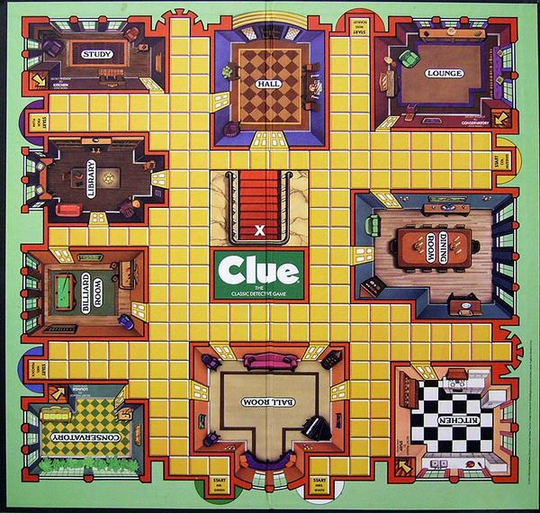
Thinking Skill # 5: Predicting and Hypothesizing
Predicting and hypothesizing helps create increased attention, focus, and curiosity at the start of instruction and more active engagement and deeper thinking throughout the construction process.
Prediction and Hypothesis-Based Hooks: These offer ways to capture student attention, stimulate curiosity and to set up new learning at the outset of student lessons and units. These can include: what if; yes, but why; puzzling question; surprising data; discrepant events; crystal ball.
Mystery: This makes the process of generating and testing hypotheses one that students want to engage in by presenting them with content-related "mysteries" and challenging them to develop and test possible explanations using teacher-provided clues.

Slide 23
Thinking Skill # 6: Visualizing and Graphic Representation
The How of Visualizing and Graphic Representation
Don't Just Say It, Display It: This is a reminder of the impact well-chosen images have on student understanding, This is more true when these images are explained and discussed in the classroom.
Visualizing Vocabulary: This promotes deep understanding of key concepts by helping students to transform them into symbols or icons and then to explain how those symbols represent essential information regarding the concept.

Slide 24
Don’t Just Say It, Display It
When teachers use an image relevant to the content, students can demonstrate their understanding by showing and explaining a picture like this one during a unit on immigration.

Slide 25
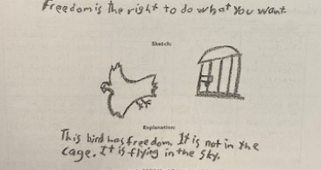
Visualizing Vocabulary
Research on vocabulary acquisition stresses the importance of teaching vocabulary as concepts rather than words to be memorized.

Slide 26
Visualizing Vocabulary
Term | Text Definition | My Definition | Image | Explanation
immigrant | People who leave their home country to live in a new country | Someone that moves to another country |  | A person that leaves one country to live in another country
opportunity | A chance or possibility | Something that could happen |  | It could improve your life or a situation
traditional | Customary, long-established | Same way of doing something over a long time |  | The way people have always done something
By challenging students to create images that represent their conceptual understanding of key vocabulary, teachers can engage students in a productive struggle.

Slide 27
Thinking Skill # 7: Perspective Taking and Empathizing
Questioning Prompts:
simple cues that help learners consider diverse perspectives and empathizing
Put the "You" in the Content:
helps students look at content through the lens of their own experiences and values
A Day in the Life:
helps create new insights by becoming the people, ideas and things they are thinking and reading about

Slide 28
Turn and Talk Activity
Before we close, let’s do one more Turn and Talk Activity. Go to one of the anchor charts labeled “Putting It All Together.” There you’ll find an envelope with ways to execute each of the basic steps for teaching a tool.

Slide 29
Putting It All Together
Basic Steps | How to Execute the Steps
1. Prepare students for new learning | Before teaching, review the tool Explain the purpose of the tool to students
2. Present and model the basic steps | Present the tool one step at a time Explain and model the individual steps. Think aloud as needed
3. Deepen and reinforce student understanding | Have students practice with guidance from you Use ongoing assessment to determine if students are ready to use the tool independently Provide additional instruction as needed
4. Challenge students to apply the tool | Assign a simple task that requires students to use the tool Assess students’ skill level and provide coaching as needed Look for further opportunities to have students use the tool Encourage students to use the tool on their own- not just when you tell them to
5. Help students reflect on and celebrate their use of that tool | Pose questions to help students reflect on their use of the tool (What came easily? What was challenging? How did using the tool enhance your thinking and understanding? What other kinds of tasks might the tool help you tackle?) Celebrate students’ successful use of the tool

Slide 30
Resources
https://www.coreknowledge.org/free-resource/ckla-domain-11-immigration/
https://www.ascd.org/books/teaching-for-deeper-learning
Notes:
As we close today, here are the resources used during the presentation.

Slide 31
Questions
Notes:
Are there any questions before we close our session today? Thank you so much for coming and we hope that you saw something to take with you to help your students build knowledge and make meaning.

Slide 32
Sherry Barnes
Demetras Jones
sbarnes@mdek12.org
demetras.jones@mdek12.org
Notes:
Here is our contact information. Please feel free to reach out to either one of us.

